Slide 1
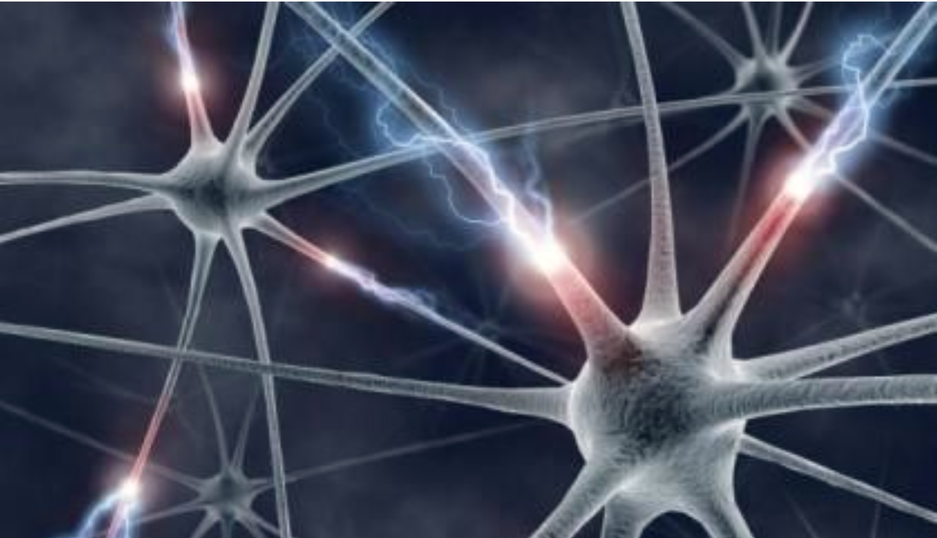



CaPC Learning: Confidential & Private Collaborative Learning
Adam Dziedzic
Postdoctoral Fellow
ady@vectorinstitute.ai
PrivateNLP Workshop @ NAACL 2021
June 11th, 2021
Notes:
Hello everyone, thank you Patricia for the introduction. My name is Adam Dziedzic and I have a pleasure to present to you CaPC Learning, which is Confidential & Private Collaborative Learning. This is supposed to be an interactive talk, so please ask questions during the talk.
I’m sorry for not showing up in the morning. I (pri-rycordyd) pre-recorded my talk and but it seems that it’s better to give it live.

Slide 2

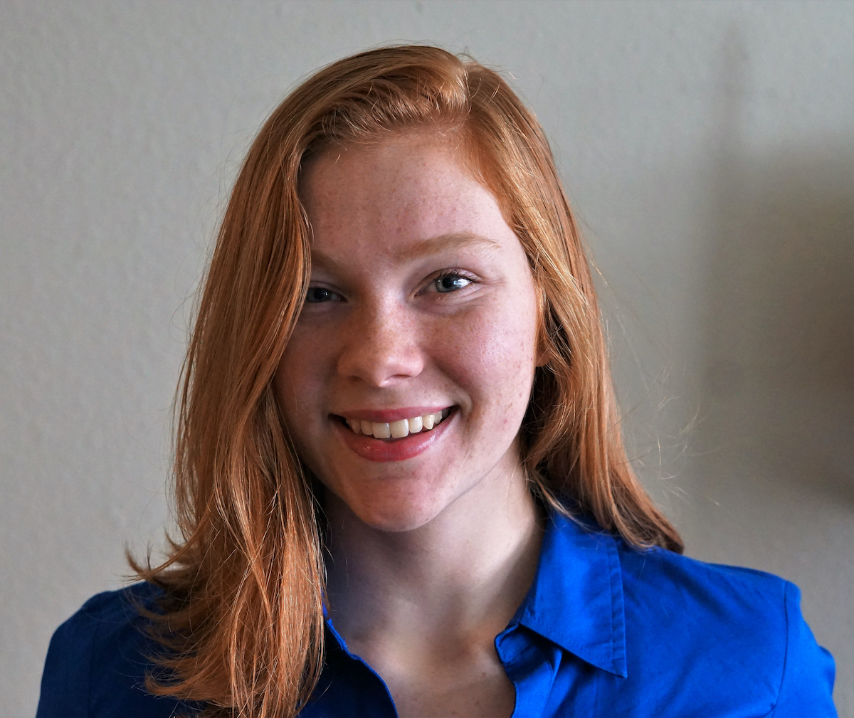
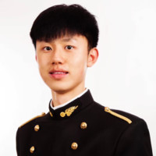
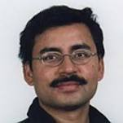
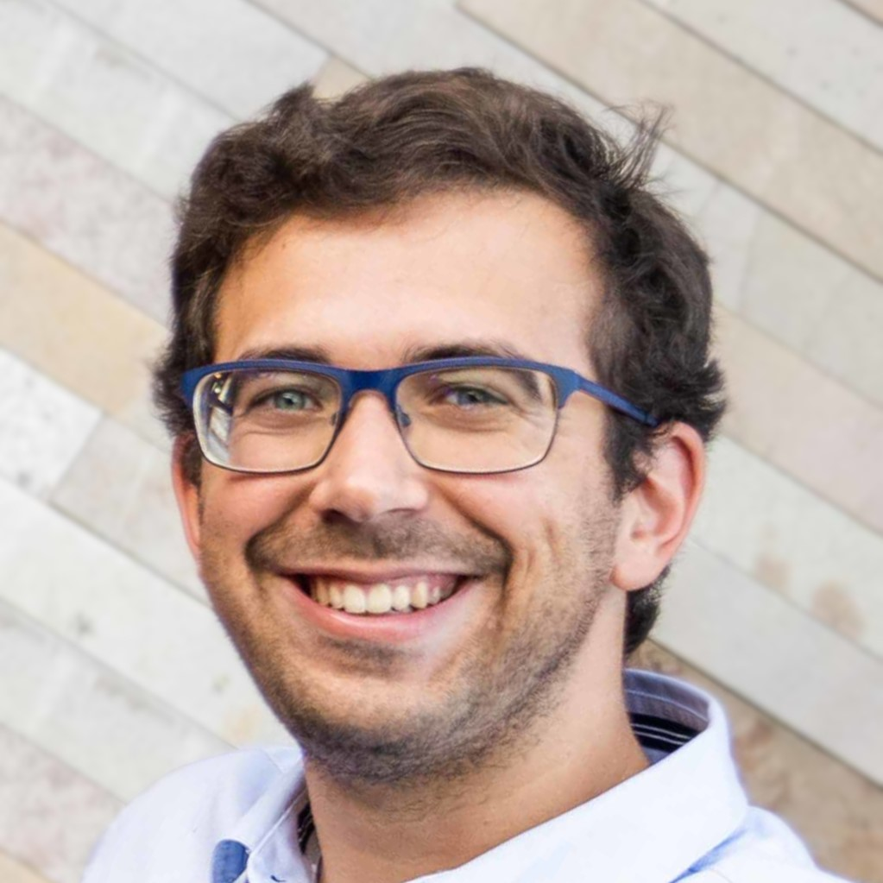
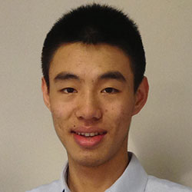
Collaborators
Christopher A.
Choquette-Choo
Natalie Dullerud
Yunxiang Zhang
Somesh Jha
Nicolas Papernot
Xiao Wang
Notes:
This is joint work with my collaborators: Chris, Natalie, Yunxiang, Somesh, Nicolas, and Xiao.

Slide 3


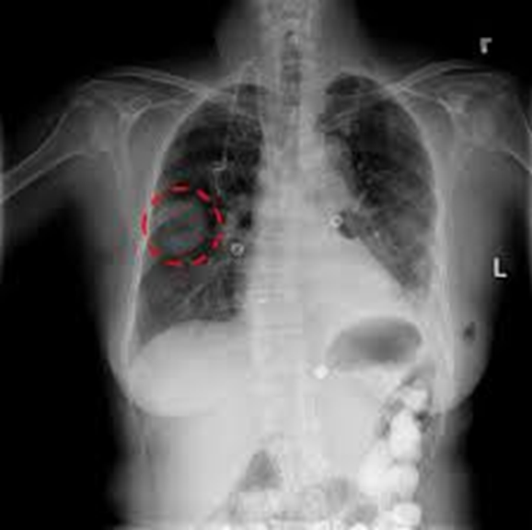
Private Consultation
Aggregation
Disease
3
Notes:
Let us imagine that there is a patient who comes to a hospital in Nothern (no’dern) Ontario in Canada. The doctor has not had such a case before. So the doctor is not confident about his or her diagnosis and wishes to consult with hospitals in Toronto (to’ronto), in Southern (sa’dern) Ontario. The doctor sends the chest X-ray of the new patient to hospitals in Toronto (to’ronto). These hospitals label the x-ray and aggregate the results to aggree on a single most probable disease. Intuitively, what we achieve is an analog of a doctor querying colleagues for a second opinion on a difficult diagnostic.

Slide 4

How to Protect Confidentiality and Privacy?
2
Aggregation
Disease
1
4
Notes:
However, there are two issues here. First, the hospitals in Toronto (to’ronto) do not want the liability for managing the private data and patient would have to allow us to send his or her data to all of these hospitals, which is a lot of paper work.

Slide 5
How to Protect Confidentiality and Privacy?
2
Aggregation
Disease
1
5
Notes:
Second problem is that the hospitals should prevent others from inferring anything about their own private data, on which they trained their models. We will show how we can solve these problems.

Slide 6
1. Requirements & Overview 2. CaPC Protocol 3. Empirical Evaluation
Notes:
My talk is divided (dy’wajdyd) into 3 main sections. First, I’ll state the requirements for CaPC and present a high-level overview of the protocol. Then, I’ll walk you through the CaPC protocol step by step. Finally, we will go through many experimental results to asses the protocol.

Slide 7
Requirements for CaPC
Requirement | What do we do?
Privacy of training data | Guarantee protection of personally identifiable information contained in training data via Differential Privacy.
Query confidentiality | Encrypt input data and do inference on encrypted data using Homomorphic Encryption and Secure Multi-Party Computation.
Model confidentiality | Prevent leakage of the answering parties’ models to the querying party.
Notes:
So, more systematically, what we want to achieve is: First, the privacy of training data. We do it via adding Gaussian random noise adaptively and achieve the (dyfe’rential) differential privacy. Model outputs (which are computed on private data) can indirectly leak information about a party’s training set. In particular, sharing model parameters, gradients, or outputs in form of logits or predictions, enables a curious querying party to infer sensitive information about the individual data records from the training set. Major inference attacks include membership inference attacks (which can determine if a given data point is part of the training set of a model) and attribute inference attacks (which infers features of the training data, or statistical information about them).

Slide 8
Requirements for CaPC
Requirement | What do we do?
Privacy of training data | Guarantee protection of personally identifiable information contained in training data via Differential Privacy.
Query confidentiality | Encrypt input data and do inference on encrypted data using Homomorphic Encryption and Secure Multi-Party Computation.
Model confidentiality | Prevent leakage of the answering parties’ models to the querying party.
Notes:
Second desideratum of CaPC is the query confidentiality. For that, we enrypt input data sent for inference and do inference on encrypted data using Homomorphic Encryption and Secure Multi-Party Computation.

Slide 9
Requirements for CaPC
Requirement | What do we do?
Privacy of training data | Guarantee protection of personally identifiable information contained in training data via Differential Privacy.
Query confidentiality | Encrypt input data and do inference on encrypted data using Homomorphic Encryption and Secure Multi-Party Computation.
Model confidentiality | Prevent leakage of the answering parties’ models to the querying party.
Notes:
Finally, regarding the model confidentiality: the querying party should not see the models that belong to the answering parties.

Slide 10

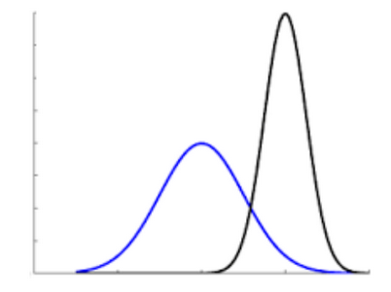
Use CaPC in Healthcare
Hospitals act as collaborating parties.
Protect privacy & confidentiality of patients’ data.
Using collaborative learning setup to investigate and possibly address some of the issues in healthcare.
Strong Privacy Guarantees
Private Consultation
Robustness to Distribution Shift
Notes:
One of the primary applications for CaPC is in the healthcare setting with hospitals acting as collaborating parties. The hospitals are obliged (e’blajdzd) to protect privacy and confidentiality of the patient’s data. CaPC provides strong privacy guarantees. It is a protocol for private consultation, and also it addresses some issues in robustness to data distribution shift.

Slide 11


Privacy of Train & Confidentiality of Test Data
Differential Privacy
Answering Parties
Labels
Healthy
Cancer
Querying
Party
Encryption
Unlabeled
Data
11
Notes:
To tackle the problems of privacy and confidentiality, we use the (dyfe’renszial) differential privacy and encryption. First, we encrypt the unlabeled data and do inference on encrypted data, which provides confidentiality. Next, we use the PATE framework to provide (dyfe’renszial) differential privacy. We aggregate the labels from the models on the left-hand side that belong to answering parties, we add Gaussian noise, and such processed labels are finaly released to the querying party.

Slide 12
CaPC Workflow
Private Inference
Blind Outputs
Compute Labels
Add DP Noise + Aggregate Labels
Unblind Final Label
1a
1b
1c
2
3
12
Notes:
What are the main processing blocks in CaPC? We start from the private inference on encrypted data. Then we blind the outputs, compute labels, add DP noise, and aggregate the labels. The last step is to unblind the final answer.

Slide 13
Actors in CaPC
Querying Party
Send encrypted query
1a
Compute
Labels
1b
1c
Unblind
Labels
Blind
Outputs
3
Label
Differential Privacy
2
Enc(q)
Answering Parties
Logits
Enc(r_{n})
P_{n}
Enc(r_{n}- r̂_{n})
Privacy Guardian
Generate random vector r̂_{n}
13
Notes:
The CaPC protocol has 3 main actors. The querying party which sends a data item to be labeled, the answering parties that run the private inference, and the 3rd trusted party called Privacy Guardian. We add the third trusted party to be able to privately aggreagate the labels and add the DP noise.

Slide 14
1. Requirements & Overview 2. CaPC Protocol 3. Empirical Evaluation
Notes:
Now, we’ll move on to the details of the CaPC protocol.

Slide 15
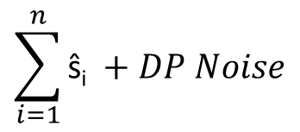
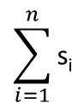
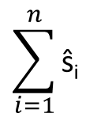
CaPC Protocol
Querying Party
(r₁- r̂₁)
s₁
$$\sum_{i=1}^{n}{\text{s}\text{i} }$$
Decrypt
. . .
. . .
P_{Q}
(r_{n}- r̂_{n})
s_{n}
P_{Q}
One-hot
encoding
Send encrypted query Enc(q)
1a
Send
Enc(r_{n} - r̂_{n})
1b
1c
ŝ_{1 …} ŝ_{n}
3
Noisy
argmax
Label
Answering Parties P₁ … P_{n}
Enc(q)
Logits
Enc(r_{n})
2
P_{n}
Enc(r_{n}- r̂_{n})
Privacy Guardian
$$\sum_{i=1}^{n}{\text{ŝ}\text{i} }$$
Gaussian noise
$$\sum_{i=1}^{n}{\text{ŝ}\text{i} }+DP Noise$$
Generate random vector r̂_{n}
15
Notes:
To make the discussed concepts more concrete, I will walk you through the CaPC protocol step-by-step. So, this diagram presents the flow of data in CaPC.

Slide 16
Private Inference
Querying Party
P_{Q}
Send encrypted query Enc(q)
1a
Answering Parties P₁ … P_{n}
16
Notes:
The goal is to label the new data item, here called a query. In step 1a, the querying party sends encrypted query to each answering party. For the encryption, we use the homomorhphic encryption.

Slide 17
Private Inference
Querying Party
P_{Q}
Send encrypted query Enc(q)
1a
Answering Parties P₁ … P_{n}
Enc(q)
Logits
Enc(r_{n})
P_{n}
17
Notes:
The answering parties do private inference on the encrypted query q. For the private inference on neural networks, we use the HE-transformer library from Intel. The library computes the linear layers (such as convolution or fully connected layers) using the homomorphic encryption. To compute the non-linear layers (such as ReLU or MaxPooling) the answering parties engage in Secure Two-Party Computation with the querying party. The results of the private inference are encrypted logits r_n (r sub n).

Slide 18
Blind Output Logits
Querying Party
P_{Q}
Send encrypted query Enc(q)
1a
1b
Answering Parties P₁ … P_{n}
Enc(q)
Logits
Enc(r_{n})
P_{n}
Enc(r_{n}- r̂_{n})
Generate random vector r̂_{n}
18
Notes:
In step 1b, each answering party generates a random vector $\hat{r}$ (r hat) and subtracts it from the encrypted logits r.

Slide 19
Decrypt Blinded Logits
Querying Party
(r₁- r̂₁)
Decrypt
. . .
P_{Q}
(r_{n}- r̂_{n})
Send encrypted query Enc(q)
1a
Send
Enc(r_{n} - r̂_{n})
1b
Answering Parties P₁ … P_{n}
Enc(q)
Logits
Enc(r_{n})
P_{n}
Enc(r_{n}- r̂_{n})
Generate random vector r̂_{n}
19
Notes:
Then, answering parties send the result to the querying party who decrypts the message to get (r - $\hat{r}$) in a plain form.

Slide 20
One-hot Encoding
Querying Party
(r₁- r̂₁)
s₁
Decrypt
. . .
. . .
P_{Q}
(r_{n}- r̂_{n})
s_{n}
One-hot
encoding
Send encrypted query Enc(q)
1a
Send
Enc(r_{n} - r̂_{n})
1b
1c
ŝ_{1 …} ŝ_{n}
Answering Parties P₁ … P_{n}
Enc(q)
Logits
Enc(r_{n})
P_{n}
Enc(r_{n}- r̂_{n})
Generate random vector r̂_{n}
20
Notes:
Then, in step 1c, the answering parties and the querying party engage in secure two-party computation to compute an argmax of the logits, and this is the predicted label by each answering party expressed as a one hot vector. They split the one-hot vector into shares s and $\hat{s}$ (s hat). The s shares are returned to the querying party and …

Slide 21
One-hot Encoding
Querying Party
(r₁- r̂₁)
s₁
Decrypt
. . .
. . .
P_{Q}
(r_{n}- r̂_{n})
s_{n}
One-hot
encoding
Send encrypted query Enc(q)
1a
Send
Enc(r_{n} - r̂_{n})
1b
1c
ŝ_{1 …} ŝ_{n}
Answering Parties P₁ … P_{n}
Enc(q)
Logits
Enc(r_{n})
P_{n}
Enc(r_{n}- r̂_{n})
Privacy Guardian
$$\sum_{i=1}^{n}{\text{ŝ}\text{i} }$$
Generate random vector r̂_{n}
21
Notes:
and the $\hat{s}$ (s hat) shares are sent to the trusted 3rd party called the Privacy Guardian. The crucial point here is that the sum of shares s and $\hat{s}$ (s hat) is (clean – meaning without any noise) - the one-hot encoding of the predicted label.

Slide 22
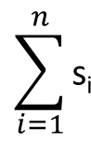
Differential Privacy
Querying Party
(r₁- r̂₁)
s₁
$$\sum_{i=1}^{n}{\text{s}\text{i} }$$
Decrypt
. . .
. . .
P_{Q}
(r_{n}- r̂_{n})
s_{n}
One-hot
encoding
Send encrypted query Enc(q)
1a
Send
Enc(r_{n} - r̂_{n})
1b
1c
ŝ_{1 …} ŝ_{n}
Answering Parties P₁ … P_{n}
Enc(q)
Logits
Enc(r_{n})
2
P_{n}
Enc(r_{n}- r̂_{n})
Privacy Guardian
$$\sum_{i=1}^{n}{\text{ŝ}\text{i} }$$
Gaussian noise
$$\sum_{i=1}^{n}{\text{ŝ}\text{i} }+DP Noise$$
Generate random vector r̂_{n}
22
Notes:
In the 2nd step, we use a (dyfe’renszial) differential privacy mechanism to provide privacy for the data on which the answering parties trained their models. The Privacy Guardian sums its $\hat{s}$ (s hat) shares from each of the answering parties and adds the Gaussian noise via PATE (patej). At the same time, the Querying party sums its s shares.

Slide 23
Noisy Argmax
Querying Party
(r₁- r̂₁)
s₁
$$\sum_{i=1}^{n}{\text{s}\text{i} }$$
Decrypt
. . .
. . .
P_{Q}
(r_{n}- r̂_{n})
s_{n}
P_{Q}
One-hot
encoding
Send encrypted query Enc(q)
1a
Send
Enc(r_{n} - r̂_{n})
1b
1c
3
ŝ_{1 …} ŝ_{n}
Noisy
argmax
Label
Answering Parties P₁ … P_{n}
Enc(q)
Logits
Enc(r_{n})
2
P_{n}
Enc(r_{n}- r̂_{n})
Privacy Guardian
$$\sum_{i=1}^{n}{\text{ŝ}\text{i} }$$
Gaussian noise
$$\sum_{i=1}^{n}{\text{ŝ}\text{i} }+DP Noise$$
Generate random vector r̂_{n}
23
Notes:
In the last 3rd step, the Privacy Guardian and the querying party use the secure multi-party computation (secure MPC) to sum the noisy $\hat{s}$ (s hat) shares with the s shares.

Slide 24
Noisy Argmax
Querying Party
(r₁- r̂₁)
$$\sum_{i=1}^{n}{\text{s}\text{i} }$$
Decrypt
. . .
P_{Q}
(r_{n}- r̂_{n})
P_{Q}
Send encrypted query Enc(q)
1a
Send
Enc(r_{n} - r̂_{n})
Healthy
Cancer
1b
3
Noisy
argmax
Label
Answering Parties P₁ … P_{n}
Enc(q)
Logits
Enc(r_{n})
P_{n}
Enc(r_{n}- r̂_{n})
Privacy Guardian
$$\sum_{i=1}^{n}{\text{ŝ}\text{i} }$$
Gaussian noise
$$\sum_{i=1}^{n}{\text{ŝ}\text{i} }+DP Noise$$
Generate random vector r̂_{n}
24
Notes:
The result is a noisy histogram of number of votes for each class. We obtained this histogram by adding the noisy one hot vectors. For illustration, here we have two classes and have to decide if a patient is Healhty or has a Cancer. We take the argmax and the class with max votes, in this case Healthy, is returned to the querying party as the predicted label.

Slide 25
Noisy Argmax
Querying Party
(r₁- r̂₁)
s₁
$$\sum_{i=1}^{n}{\text{s}\text{i} }$$
Decrypt
. . .
. . .
P_{Q}
(r_{n}- r̂_{n})
s_{n}
P_{Q}
One-hot
encoding
Send encrypted query Enc(q)
1a
Send
Enc(r_{n} - r̂_{n})
1b
1c
3
ŝ_{1 …} ŝ_{n}
Noisy
argmax
Label
Answering Parties P₁ … P_{n}
Enc(q)
Logits
Enc(r_{n})
2
P_{n}
Enc(r_{n}- r̂_{n})
Privacy Guardian
$$\sum_{i=1}^{n}{\text{ŝ}\text{i} }$$
Gaussian noise
$$\sum_{i=1}^{n}{\text{ŝ}\text{i} }+DP Noise$$
Generate random vector r̂_{n}
25
Notes:
The labeled query can also be used to retrain the querying party’s model. There are many details in the CaPC protocol so usually, there are many questions here… Please, feel free to ask your questions.

Slide 26
Confidentiality & Privacy Guarantees
Honest-but-curious setting – adversary follows the protocol but tries to infer information from the protocol transcript.
Semi-trusted third party - PG (Privacy Guardian) does not collude with any other party.
If PG colludes with a querying party (and no noise added) – there is no privacy protection.
Perfect confidentiality – assumed above, protocol reveals nothing except the final noised result to the querying party.
Strong privacy – when at most 1 corrupted answering party.
Privacy degrades only and proportionally to the number of corrupted answering parties.
Privacy leakage only to the querying party when more than a single answering party is corrupted.
Notes:
What are the guarantees provided by the CaPC protocol in terms of the confidentiality and privacy. First, the assumption is that the protocol is executed in an honest-but-curious setting and the Privacy Guardian is a semi-trusted third party that does not collude with any other party. We provide perfect confidentiality since the protocol reveals only the noisy prediction to the querying party. We have strong privacy protection when there is at most 1 corrupted answering party.

Slide 27
Confidentiality & Privacy Guarantees
Honest-but-curious setting – adversary follows the protocol but tries to infer information from the protocol transcript.
Semi-trusted third party - PG (Privacy Guardian) does not collude with any other party.
If PG colludes with a querying party (and no noise added) – there is no privacy protection.
Perfect confidentiality – assumed above, protocol reveals nothing except the final noised result to the querying party.
Strong privacy – when at most 1 corrupted answering party.
Privacy degrades only and proportionally to the number of corrupted answering parties.
Privacy leakage only to the querying party when more than a single answering party is corrupted.
Notes:
One or more corrupted parties have no impact on confidentiality. The privacy guarantee degrades proportionally to the number of corrupted answering parties. The potential privacy leakage is to the querying party. The worst scenario in terms of privacy is when the Privacy Guaradian colludes with the querying party. Then there is no privacy protection.

Slide 28
1. Requirements & Overview 2. CaPC Protocol 3. Empirical Evaluation
Notes:
Hopefully, the details of the CaPC protocol are clear now, and we can move on to the empirical evaluation.

Slide 29
Homogenous Architecture
SVHN on VGG-7, 250 parties, $ε=2.0$, $δ={10}^{−6}$, uniform distribution
29
Notes:
First, we investigate the benefits of collaboration for improving the performance of a model in the querying party. The y axis represents accuracy and the x axis represents the class number from the SVHN dataset. The goal of this task is to recognize digits from the street view of house numbers. We use VGG-7 architecture, set the number of collaborating parties to 250. Regarding the $\left(ε, δ\right)$ parameters for the DP privacy. The maximum privacy budget $ε$ is set to 2 and delta to 10 to (-6), which is the inverse of number data points in the SVHN dataset. We assume that each party has the same data distribution.

Slide 30
Homogenous Architecture
SVHN on VGG-7, 250 parties, $ε=2.0$, $δ={10}^{−6}$, uniform distribution
30
Notes:
We plot in blue the per-class accuracy for the querying party’s model before running the CaPC protocol.

Slide 31
Homogenous Architecture
SVHN on VGG-7, 250 parties, $ε=2.0$, $δ={10}^{−6}$, uniform distribution
31
Notes:
The red columns represent the per-class accuracy after running the CaPC protocol. We observe the increase of the accuracy for each class.

Slide 32
Homogenous Architecture
SVHN on VGG-7, 250 parties, $ε=2.0$, $δ={10}^{−6}$, uniform distribution
2%
32
Notes:
We also present the average accuracy across all classes. The blue dashed line is accuracy before CaPC and the red dashed line is accuracy after running the CaPC protocol. Overall, the increase in accuracy of the querying party is by about 2%.

Slide 33
Heterogenous Architecture
SVHN on VGG-7, ResNet-8, ResNet-10, 250 parties, $ε=2.0$, $δ={10}^{−6}$, uniform distribution
33
Notes:
In this experiment we investigate the situation in which the answering parties have models with different types of architecture. We use VGG-7, ResNet-8, and ResNet-10. All the other settings are the same as in the previous experiment.

Slide 34
Heterogenous Architecture
SVHN on VGG-7, ResNet-8, ResNet-10, 250 parties, $ε=2.0$, $δ={10}^{−6}$, uniform distribution
34
Notes:
We plot in blue the per-class accuracy for the model in querying party before running the CaPC protocol. We run the experiment for different types of architecture in the answering parties. We use: VGG-7, ResNet-8, or ResNet-10. There are 250 collaborating parties. We set the maximum privacy budget to 2 and delta is set to the inverse of the data points in the SVHN dataset. We assume that the data is uniformly distributed in each of the parties.

Slide 35
Heterogenous Architecture
SVHN on VGG-7, ResNet-8, ResNet-10, 250 parties, $ε=2.0$, $δ={10}^{−6}$, uniform distribution
2.6%
35
Notes:
The overall accuracy gain after running CaPC is of about 2.6%. Thus, CaPC enables the collaboration between parties that have models with different types of architecture and helps to improve the accuracy of the models.

Slide 36
Active Learning
36
Notes:
Before we move on to the next experiment, we’ll have a short segue (seguej) into active learning.

Slide 37
Active Learning for Query Selection
Given: an unlabeled dataset $d$ and a classification model with conditional label distribution $P_{θ}\left(y | x\right)$, where $x∈d$.
37
Notes:
The querying party decides which data samples to send to the anwering parties for labeling. We harness active learning methods for this task. So, assume we are given an ulabeled dataset d and conditional label distribution: $P_{θ}(y|x)$ (P sub theta of y given x), P is parameterized by $θ$ which in this case are parameters of a neural network model.

Slide 38
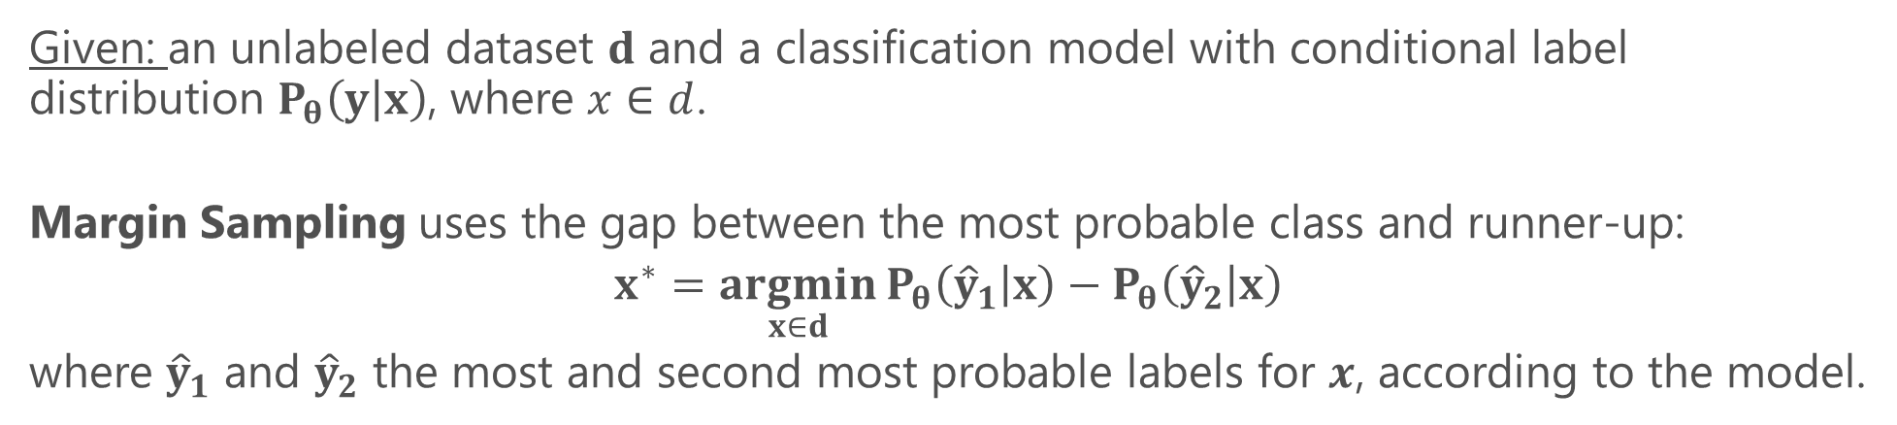
Active Learning for Query Selection
Given: an unlabeled dataset $d$ and a classification model with conditional label distribution $P_{θ}\left(y | x\right)$, where $x∈d$.
Margin Sampling uses the gap between the most probable class and runner-up:
$$x^{∗}=\underset{x∈d}{argmin}{P_{θ}\left({\hat{y}}_{1} | x\right)}−P_{θ}\left({\hat{y}}_{2} | x\right)$$
where ${\hat{y}}_{1}$ and ${\hat{y}}_{2}$ the most and second most probable labels for $x$, according to the model.
38
Notes:
We use, for example, the margin sampling method. The intuition behind this method is that the smaller the gap between the most probable class and the runner up, the more information can be provided by labeling this sample.

Slide 39
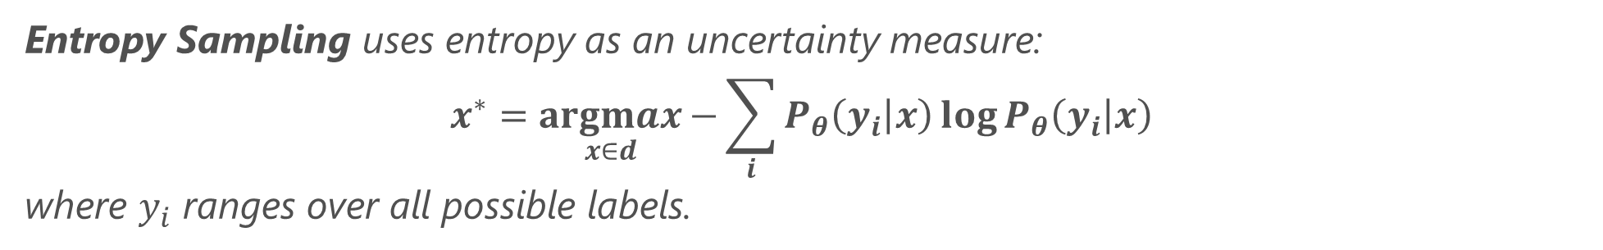
Active Learning for Query Selection
Given: an unlabeled dataset $d$ and a classification model with conditional label distribution $P_{θ}\left(y | x\right)$, where $x∈d$.
Margin Sampling uses the gap between the most probable class and runner-up:
$$x^{∗}=\underset{x∈d}{argmin}{P_{θ}\left({\hat{y}}_{1} | x\right)}−P_{θ}\left({\hat{y}}_{2} | x\right)$$
where ${\hat{y}}_{1}$ and ${\hat{y}}_{2}$ the most and second most probable labels for $x$, according to the model.
Entropy Sampling uses entropy as an uncertainty measure:
$$x^{∗}=\underset{x∈d}{argmax}{−\sum_{i}{P_{θ}\left(y_{i} | x\right)}\log{P_{θ}\left(y_{i} | x\right)}}$$
where $y_{i}$ ranges over all possible labels.
39
Notes:
We also employ the entropy sampling. Intuitively, we select the sample whose probability distribution is closer to the uniform distribution. On the other hand, if the distribution of probabilities of classes for a given sample is close to a deterministic one, probability of a single class is dominant, then its entropy is almost zero – which means that we know which is the most probable label for the sample, and usually we do not need to label such a sample.

Slide 40
Non-uniform Data Distribution
SVHN on VGG-7, 250 parties, $ε=2.0$, $δ={10}^{−6}$, classes 1 & 2 are under-represented
40
Notes:
In this experiment, we want to analyze how CaPC can improve balanced accuracy when there is a skew of the initial training data in the querying party. The y axis represents the balanced accuracy and x axis represents the class number. Classes 1 and 2 are under-represented in the initial data. We used the balanced accuracy since this metric better captures model utility in terms of both accuracy and fairness when the data is imbalanced. The balanced accuracy metric is an average of accuracy or recalls obtained per class.

Slide 41
Non-uniform Data Distribution
SVHN on VGG-7, 250 parties, $ε=2.0$, $δ={10}^{−6}$, classes 1 & 2 are under-represented
5.7%
41
Notes:
We observe that CaPC with different sampling methods increases the balanced accuracy of the querying model by about 5.7%.

Slide 42
Non-uniform Data Distribution
SVHN on VGG-7, 250 parties, $ε=2.0$, $δ={10}^{−6}$, classes 1 & 2 are under-represented
42
Notes:
When we zoom in the two under-represented classes 1 and 2, we see that the entropy and margin sampling methods increased the balanced accuracy of these classes more than the random selection of samples. This is because the less-represented classes have a higher margin and entropy, and samples from these less represented classes are selected more frequently. In general, CaPC can significantly improve the fair performance of models as measured by balanced accuracy, especially when combined with active learning.

Slide 43
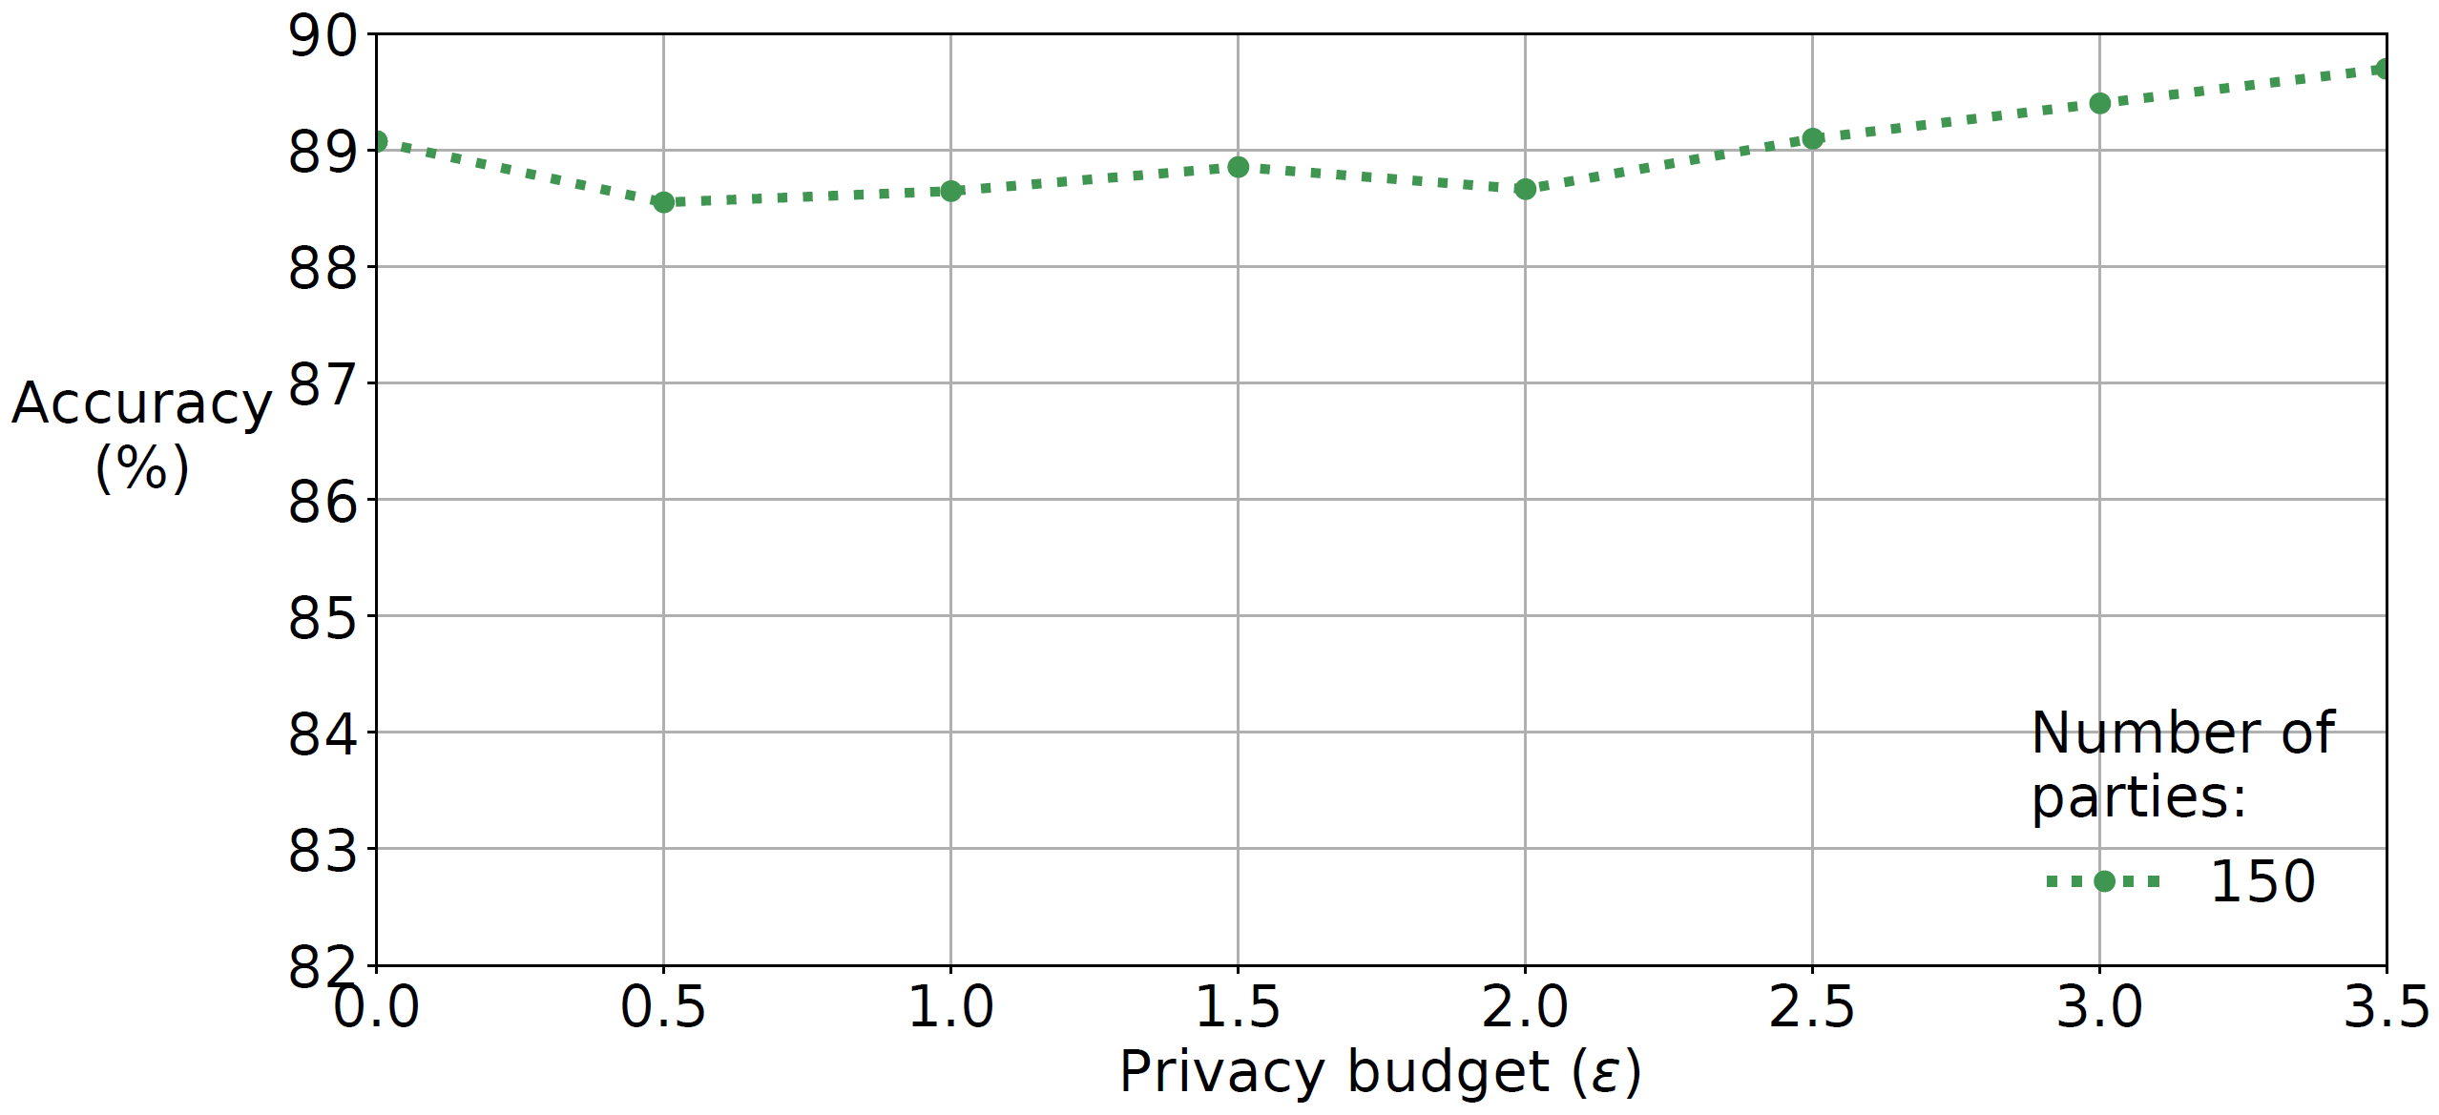
Accuracy Gain vs Number of Parties
SVHN on VGG-7, 250 parties, $ε=2.0$, $δ={10}^{−6}$, uniform distribution
0.62%
43
Notes:
Here, we want to analyze accuracy gain in CaPC as we increase the number of collaborating parties. The gain in accuracy is relatively small for 150 parties involved in CaPC. However, the teacher models already have high accuracy of about 89% becuase we trained the models on relatively large data subsets. In this case we observe a gain in accuracy for the privacy budget of about 3.5.
What is the delta parameter for DP in this experiment? This is the inverse of the number of samples which is 10 ^ (-6).

Slide 44
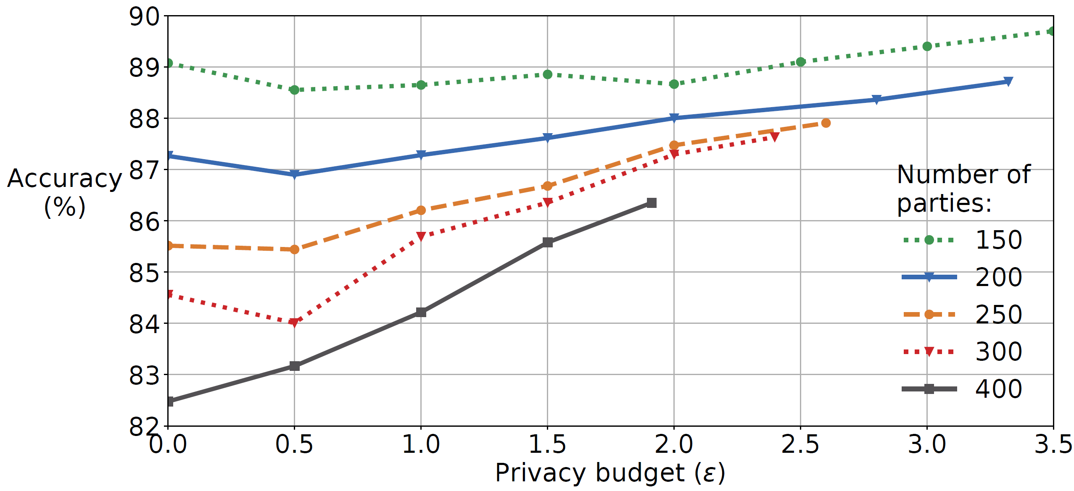
Accuracy Gain vs Number of Parties
SVHN on VGG-7, 250 parties, $ε=2.0$, $δ={10}^{−6}$, uniform distribution
3.87%
44
Notes:
On the other hand, with many more parties, for example, with 400 parties, the accuracy of the individual models is low, about 82.5% because the models are trained on smaller data subsets. The accuracy gain is substantial, about 3.87% and also it is obtained for a lower privacy budget of about 1.9. In general, we observe that the more parties collaborate in CaPC, the tighter the bound on privacy budget epsilon and higher gains in accuracy.

Slide 45
Computational Cost of Private Inference
1a
45
Notes:
In this experiment we measure the utilization of resources (CPU, Network transfer (denoted as NET), and memory usage (denoted as MEM)) during execution of the private inference, which is step 1a in the CaPC protocol. The network usage reaches its peaks during execution of ReLU, then two AveragePooling operations and then a single ReLU layer, where the intermediate feature maps have to be exchanged between the querying and answering parties for the Secure Multi-Party Computation. The peaks in the CPU utilization are due to the computation of 2 convolutional layers and 2 fully connected layers. This micro-benchmark was done for a small version of LeNET and MNIST dataset, so the memory overhead is negligible.

Slide 46
Small Computational Overhead of CaPC
Private
Inference
(only)
1a
CaPC
46
Notes:
CaPC does not add much overhead on top of the Private Inference. Private Inference is the main performance bottleneck in the protocol. CaPC only exchanges a few vectors so not much more network transfer is required and the computational cost is also relatively low.

Slide 47
CaPC | Federated Learning
Cross-silo setting, e.g., organizations | Cross-device setting, e.g., phones
Improve local models in each party by labeling new data points | Train central model without explicitly combining the parties’ datasets
For heterogenous models and also non-differentiable models (trees) | Only for homogenous and differentiable models
Returns only predicted labels | Transfers gradients or parameters (large data transfer required)
Fewer parties required for privacy | Many more parties required
Provides confidentiality of data to be labeled & privacy (no gradients revealed) via Pâté. | Provides condifentiality but much higher cost of privacy (gradients shared allow us to infer private data)
Notes:
Before we conclude, I wanted to compare CaPC with Federated (fede’rejtyd) Learning from different perspectives, such as the setting where the frameworks can be used, model architecture, and privacy.

Slide 48
CaPC | Federated Learning
Cross-silo setting, e.g., organizations | Cross-device setting, e.g., phones
Improve local models in each party by labeling new data points | Train central model without explicitly combining the parties’ datasets
For heterogenous models and also non-differentiable models (trees) | Only for homogenous and differentiable models
Returns only predicted labels | Transfers gradients or parameters (large data transfer required)
Fewer parties required for privacy | Many more parties required
Provides confidentiality of data to be labeled & privacy (no gradients revealed) via Pâté. | Provides condifentiality but much higher cost of privacy (gradients shared allow us to infer private data)
Notes:
First, the setting in CaPC is cross-silo (sajlou), where the parties are organizations such as hospitals or banks. Federated (fede’rejtyd) Learning targest cross-device settings, where the parties are, for example, our smatphones.

Slide 49
CaPC | Federated Learning
Cross-silo setting, e.g., organizations | Cross-device setting, e.g., phones
Improve local models in each party by labeling new data points | Train central model without explicitly combining the parties’ datasets
For heterogenous models and also non-differentiable models (trees) | Only for homogenous and differentiable models
Returns only predicted labels | Transfers gradients or parameters (large data transfer required)
Fewer parties required for privacy | Many more parties required
Provides confidentiality of data to be labeled & privacy (no gradients revealed) via Pâté. | Provides condifentiality but much higher cost of privacy (gradients shared allow us to infer private data)
Notes:
In CaPC, we aim at improving local models by collaboratively labeling new data points. In Federated (fede’rejtyd) Learninng, we want to train a central model without explicitely combining parties’ datasets.

Slide 50
CaPC | Federated Learning
Cross-silo setting, e.g., organizations | Cross-device setting, e.g., phones
Improve local models in each party by labeling new data points | Train central model without explicitly combining the parties’ datasets
For heterogenous models and also non-differentiable models (trees) | Only for homogenous and differentiable models
Returns only predicted labels | Transfers gradients or parameters (large data transfer required)
Fewer parties required for privacy | Many more parties required
Provides confidentiality of data to be labeled & privacy (no gradients revealed) via Pâté. | Provides condifentiality but much higher cost of privacy (gradients shared allow us to infer private data)
Notes:
CaPC has no assumption on the types of model architecture. Models can be heterogenous or non-differentiable (e.g., decision trees or random forests). Whereas in Federated (fede’rejtyd) Learning, we require homogenous architectures and differentiable models.

Slide 51
CaPC | Federated Learning
Cross-silo setting, e.g., organizations | Cross-device setting, e.g., phones
Improve local models in each party by labeling new data points | Train central model without explicitly combining the parties’ datasets
For heterogenous models and also non-differentiable models (trees) | Only for homogenous and differentiable models
Returns only predicted labels | Transfers gradients or parameters (large data transfer required)
Fewer parties required for privacy | Many more parties required
Provides confidentiality of data to be labeled & privacy (no gradients revealed) via Pâté. | Provides condifentiality but much higher cost of privacy (gradients shared allow us to infer private data)
Notes:
CaPC returns only labels, which allows us to transfer much less data. While Federated Learning transfers gradients, parameters, or other model updates.

Slide 52
CaPC | Federated Learning
Cross-silo setting, e.g., organizations | Cross-device setting, e.g., phones
Improve local models in each party by labeling new data points | Train central model without explicitly combining the parties’ datasets
For heterogenous models and also non-differentiable models (trees) | Only for homogenous and differentiable models
Returns only predicted labels | Transfers gradients or parameters (large data transfer required)
Fewer parties required for privacy | Many more parties required
Provides confidentiality of data to be labeled & privacy (no gradients revealed) via Pâté. | Provides condifentiality but much higher cost of privacy (gradients shared allow us to infer private data)
Notes:
Fewer parties, roughly hundreads, can collaborate in CaPC while still preserving their privacy. Federated Learning requires millions of parties to preserve their privacy.

Slide 53
CaPC | Federated Learning
Cross-silo setting, e.g., organizations | Cross-device setting, e.g., phones
Improve local models in each party by labeling new data points | Train central model without explicitly combining the parties’ datasets
For heterogenous models and also non-differentiable models (trees) | Only for homogenous and differentiable models
Returns only predicted labels | Transfers gradients or parameters (large data transfer required)
Fewer parties required for privacy | Many more parties required
Provides confidentiality of data to be labeled & privacy (no gradients revealed) via Pâté. | Provides condifentiality but much higher cost of privacy (gradients shared allow us to infer private data)
Notes:
CaPC provides confidentiality via private inference and privacy via PATE (patej). Federated Learning provides confidentiality but higher cost of privacy loss, because shared gradients, parameters, or other model updates allow us to infer private data.

Slide 54
Conclusions
CaPC protocol for privacy preserving collaboration and learning.
Privacy of train data with differential privacy & Pâté.
Confidentiality of test data via secure multi-party computation and homomorphic encryption.
Participants label their new data items and use them to improve their own ML models.
CaPC improves performance of models with heterogenous architectures and when there is skew in data.
Notes:
In conclusion. CaPC protocol provides confidential and private collaborative learning. The privacy of the training data from the answering parties is preserved using differential privacy via the PATE framework. On the other hand, the confidentiality of the test data from querying parties is provided using secure multi-party computation and homomorphic encryption. We use active learning methods for query selection and show improvement of models from the querying parties when we deal with heterogeneous architectures or a skew in datasets.

Slide 55
Thank you
55
Notes:
With that, I’d like to thank you for your attention and I’d be happy to answer any more questions.

Slide 56
Backup
56
Notes:
Backup

Slide 57
Definitions
Privacy - aims to guarantee proper protection of personally identifiable information, against inference attacks.
Confidentiality - aims to guarantee non-disclosure of sensitive information to unauthorized entities.
Integrity - aims to prevent unauthorized modification of data and models.
Secure Multi-Party Computation – a way for parties to compute a function jointly while keeping their inputs secret. In ML, this function can be a model’s loss function during training, or the model itself in inference.
Notes:
Secure MPC - For example, in the medical field, a cloud service provider could run a trained classification model on secretly shared patient data and send the secretly shared result (e.g., a prediction of a disease) back to the patient. However, this can leak private information about the training set on which the model was trained.
The goal of a secure two party computation for parties x, y is to compute a common function F that takes inputs from x and y by exchanging messages only with each other without revealing their inputs and without having to rely on a third trusted party. The parties should learn no more by engaging in their protocol than they would learn by interacting with an incorruptible, perfectly trustworthy third party. In particular, all that the parties can learn is what they can learn from the output and their own input.
splitting the data into shares is the encryption, adding the shares back together is the decryption,

Slide 58
Definitions
Secret Sharing - splitting the data into shares is the encryption, adding the shares back together is the decryption.
Notes:
Secure MPC - for example, in the medical field, a cloud service provider could run a trained classification model on secretly shared patient data and send the secretly shared result (e.g., a prediction of a disease) back to the patient. However, this can leak private information about the training set on which the model was trained.
Secret sharing - splitting the data into shares is the encryption, adding the shares back together is the decryption.

Slide 59
CaPC | Federated Learning
Cross-silo setting, e.g., organizations | Cross-device setting, e.g., phones
Improve local models in each party by labeling new data points | Train central model without explicitly combining the parties’ datasets
For heterogenous models and also non-differentiable models (trees) | Only for homogenous and differentiable models
Returns only predicted labels | Transfers gradients or parameters (large data transfer required)
Fewer parties required for privacy | Many more parties required
Provides confidentiality of data to be labeled & privacy (no gradients revealed) via Pâté. | Provides condifentiality but much higher cost of privacy (gradients shared allow us to infer private data)
Notes:
Before we conclude, I wanted to compare CaPC with Federated (fede’rejtyd) Learning from different perspectives, such as setting where the frameworks can be used, models, and privacy. First, the setting in CaPC is cross-silo (sajlou), where the parties are organizations such as hospitals or banks. Federated (fede’rejtyd) Learning targest cross-device settings, where the parties are, for example, our smatphones. In CaPC, we aim at improving local models by collaboratively labeling new data points. In Federated (fede’rejtyd) Learninng, we want to train a central model without explicitely combining parties’ datasets. CaPC has no assumption on the types of model architecture. Models can be heterogenous or non-differentiable (e.g., decision trees or random forests). Whereas in Federated (fede’rejtyd) Learning, we require homogenous architectures and differentiable models. CaPC returns only labels, which allows us to transfer much less data. While Federated Learning transfers gradients, parameters, or other model updatess. Fewer parties, roughly hundreads, can collaborate in CaPC while still preserving their privacy. Federated Learning requires millions of parties to preserve their privacy. CaPC provides confidentiality via private inference and privacy via PATE (patej). Federated Learning provides confidentiality but much higher cost of privacy, because of shared gradients, parameters, or other model updates allow us to infer private data.

Slide 60
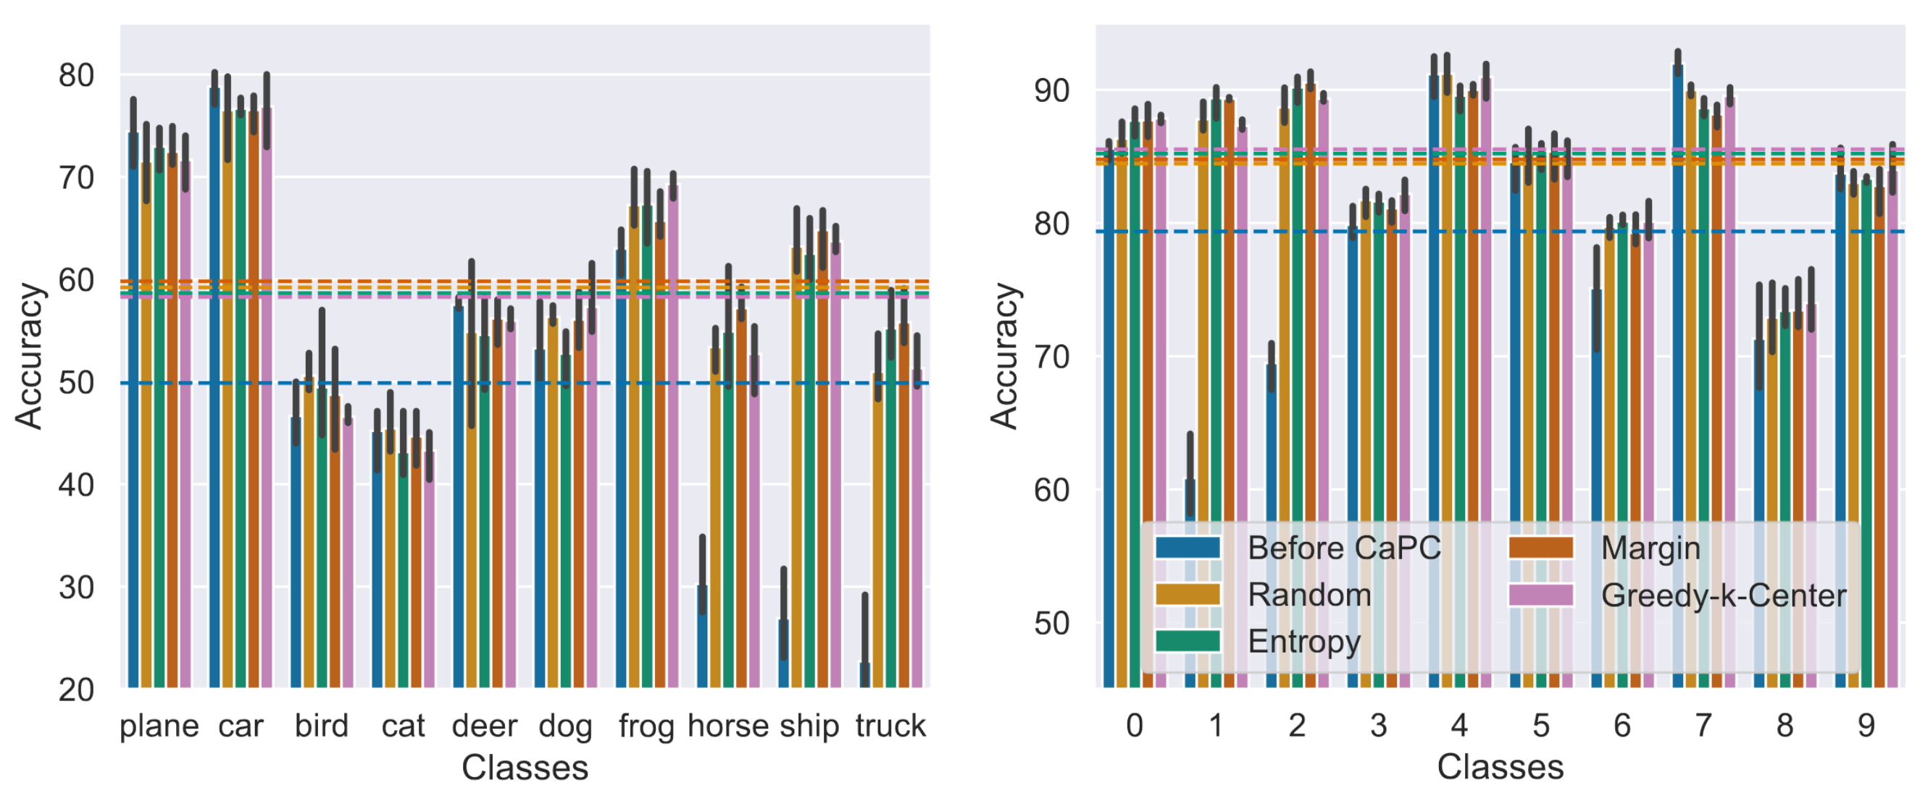
Balanced accuracy under non-uniform data distribution via Active Learning
Notes:
We use CaPC with active learning to improve balanced accuracy under non-uniform data distribution. The blue dashed line is accuracy before CaPC. We observe that all sampling strategies significantly improve balanced accuracy. The best active learning scheme can improve balanced accuracy by a total of 9.94 percentage-points (an additional 0.8 percentage points over Random sampling) on CIFAR10 (left) using Margin method and a total of 5.67 percentage-points (an additional 0.38) on SVHN (right) using the Greedy-k-Center.

Slide 61
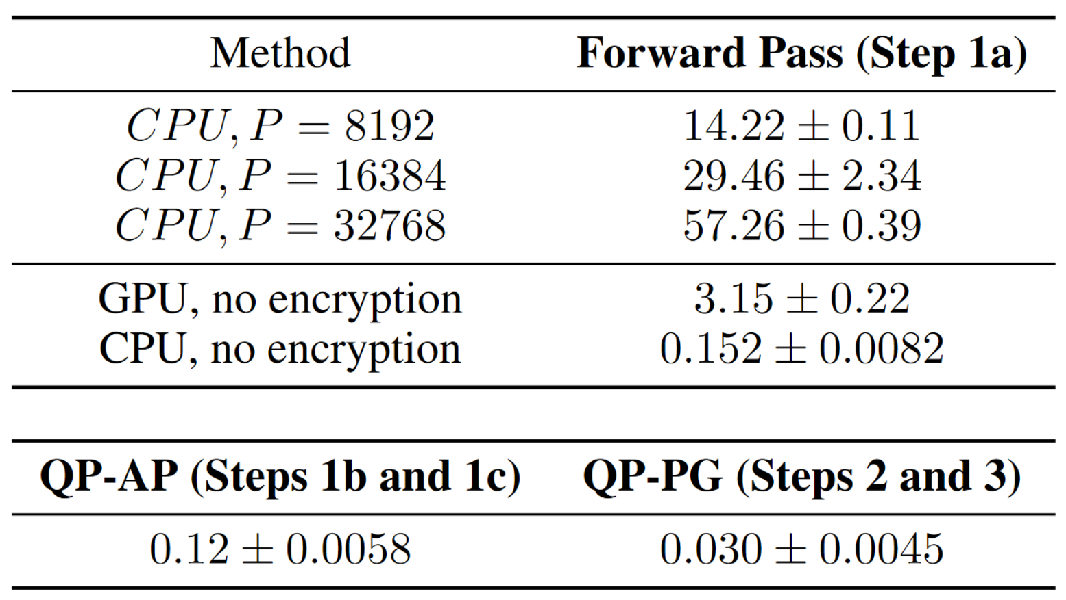
Break-down of the execution time
Notes:
Wall-clock time (sec) of various encryption methods with a batch size of 1.We vary the modulus range, P for homomorphic encryption, which denotes the max value of a given plain text number. Note that the GPU is slower than the CPU because of the mini-batch with a single data point and data transfer overhead to and from the GPU. We use the CryptoNet-ReLU model provided by HE-transformer.

Slide 62

Cost of Protecting Confidentiality & Privacy
Private Inference
Differential Privacy
Homomorphic Encryption & Secure Multi Party Computation
Healthy
Cancer
Adds Gaussian Noise
62
Notes:
In the current version of our system, the highest cost in terms of the execution time is due to the private inference, to protect the confidentiality of the queries. The protection of the privacy of the training data is much cheaper.

Slide 63
Expensive Query Privacy & Cheaper DP
Differential Privacy
Private
Inference
Labels
Healthy
Cancer
Querying
Party
Encryption
Unlabeled
Data
63
Notes:
To tackle these two problems we use encryption and differential privacy. First, we encrypt the unlabeled data. We do inference on encrypted data, which provides confidentiality. Next, we use PATE framework to provide differential privacy on which we trained the models on the left. We aggregate the labels from the answering parties, add Gaussian noise, and such processed labels are finaly released to the querying party.

Slide 64

Centralized Machine Learning
Train
Data + Labels
Model
Inference
Unlabeled Data
Labels
Trained Model
Notes:
In the centralized Machine Learning setup, we gather all the data and labels in a central location. We use them to train a model. When new data comes, we take the train model, run the inference and the model returns labels for the new data. Emphasize, we focus on inference.

Slide 65
CaPC Protocol
Querying Party
(r₁- r̂₁)
s₁
$$\sum_{i=1}^{n}{\text{s}\text{i} }$$
Decrypt
. . .
. . .
P_{Q}
(r_{n}- r̂_{n})
s_{n}
P_{Q}
One-hot
encoding
Send encrypted query Enc(q)
1a
Send
Enc(r_{n} - r̂_{n})
1b
1c
3
ŝ_{1 …} ŝ_{n}
Noisy
argmax
Label
Answering Parties P₁ … P_{n}
Enc(q)
Logits
Enc(r_{n})
2
P_{n}
Enc(r_{n}- r̂_{n})
Privacy Guardian
$$\sum_{i=1}^{n}{\text{ŝ}\text{i} }$$
Gaussian noise
$$\sum_{i=1}^{n}{\text{ŝ}\text{i} }+DP Noise$$
Generate random vector r̂_{n}
65
Notes:
To make this concepts more concrete, we will walk you through the CaPC protocol. In step 1a, we send encrypted query to the answering parties. They compute an encypted label. In step 1b, we generate random vector, subtract it from the logits, and send the the querying party. In step 1c, the querying party and the answering parties engage in a secure multi-party computation to compute the one-hot vectors. One part of the shares is sent to the 3rd trusted party called CSP, and the other part of shars is sent to the querying party. In step 2, the trusted 3rd party sums its shares and adds DP noise. At the same time, theq querying party sums its shares. Finaly, we compute the argmax to choose the label that models returned most often and unblind the final label to the querying party.

Slide 66
Motivation
Privacy concerns prevent us from sharing our private data:
medical history, dental history, phone number, address, current location, web activities, etc.
Legislative directives: GDPR (EU), PIPEDA (Canada), etc.
Indirect access to data via ML can reveal sensitive information:
membership inference – determine if a given record was in a model’s training dataset.
secret sharer – shows that we can extract SSN (Social Security Number) used for training a model.
Hospital & banks would like to collaborate:
They cannot combine their data in a single location.
The data cannot be shared between them.
They cannot collaborate or share predictions of their ML models.
Notes:
In Conclusion. CaPC protocol provides confidential and private collaborative learning. The privacy of training data from the answering parties is preserved using differential privacy via the PATE framework. On the other hand, the confidentiality of the test data from querying parties is provided using secure multi-party computation and homomorphic encryption. We use active learning methods for query selection and show improvement of the model from the querying parties when we deal with heterogeneous architectures or a skew in datasets.
Confidentiality aims to guarantee non-disclosure of sensitive information to unauthorized entities.
Privacy aims to guarantee proper protection of personally identifiable information, against inference attacks.
Integrity aims to prevent unauthorized modification of data and models.

Slide 67
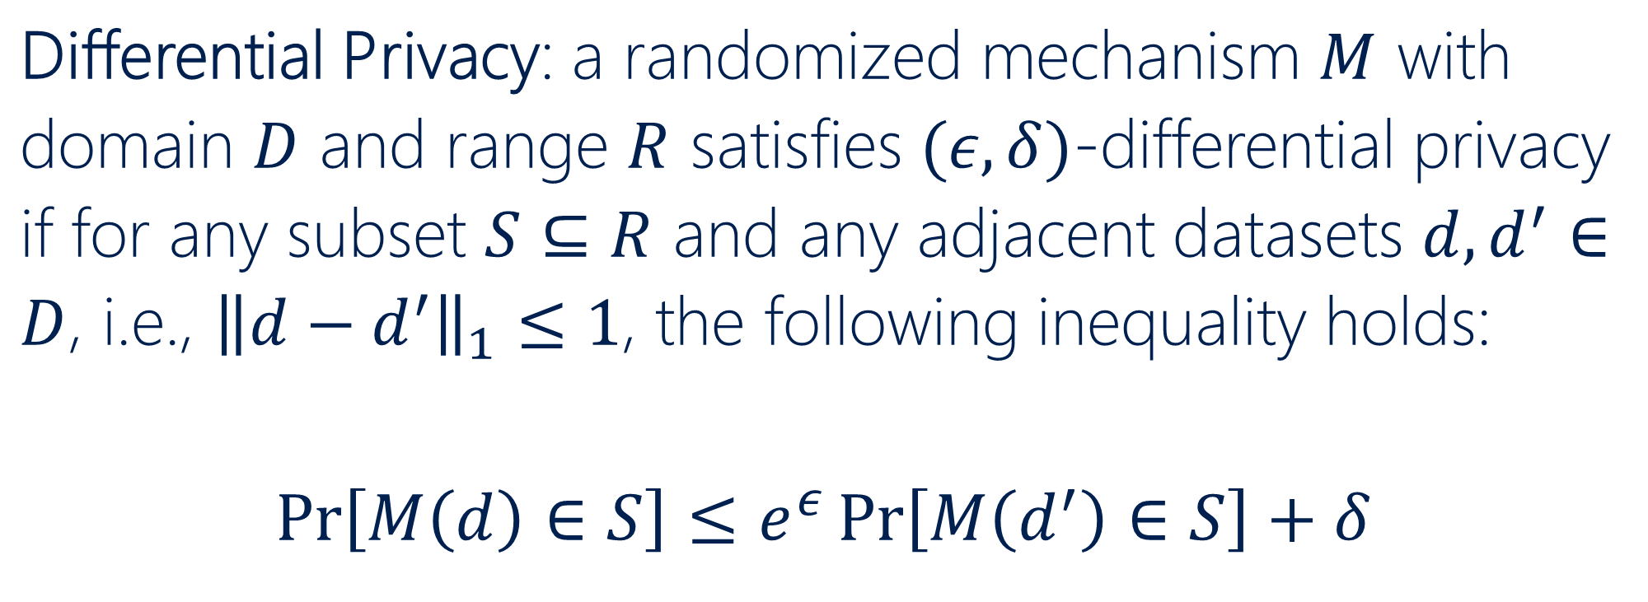
Differential Privacy in Machine Learning
Goal: produce statistically indistinguishable outputs on any pair of datasets that only differ by any single data point.
Differential Privacy: a randomized mechanism $M$ with domain $D$ and range $R$ satisfies $(ε,δ)$-differential privacy if for any subset $S⊆R$ and any adjacent datasets $d,d^{′}∈D$, i.e., ${\left\|d−d^{′}\right\|}_{1}≤1$, the following inequality holds:
$$\operatorname{Pr}\left[M\left(d\right)∈S\right]≤e^{ε}\operatorname{Pr}\left[M\left(d^{′}\right)∈S\right]+δ$$
Notes:
In the context of machine learning, differential privacy requires the training algorithm to produce statistically indistinguishable (similar) outputs on any pair of datasets that only differ by one datapoint. This implies that an adversary observing the outputs of the training algorithm (e.g., the model parameters, or its predictions) can improve its guess at most by a bounded probability when inferring properties of the training data points. Formally, we have the following definition of differential privacy.

Slide 68
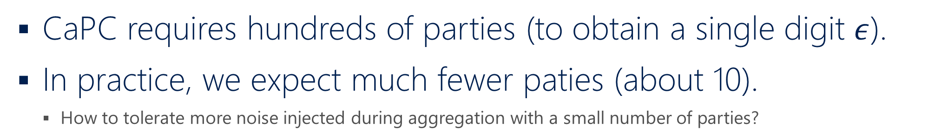
How to decrease number of parties?
CaPC requires hundreds of parties (to obtain a single digit $ε$).
In practice, we expect much fewer paties (about 10).
How to tolerate more noise injected during aggregation with a small number of parties?
Notes:
The question is how to decrease the number of parties involved in CaPC and keep the privacy budget low. Currently, CaPC requires hundreds of parties but in practice, we expect 10 or so parties. However, the amount of noise that we can inject when having a small number of parties is very limited and we want to keep the privacy budget $ε$ small (in practice – it should be a single digit number).

Slide 69
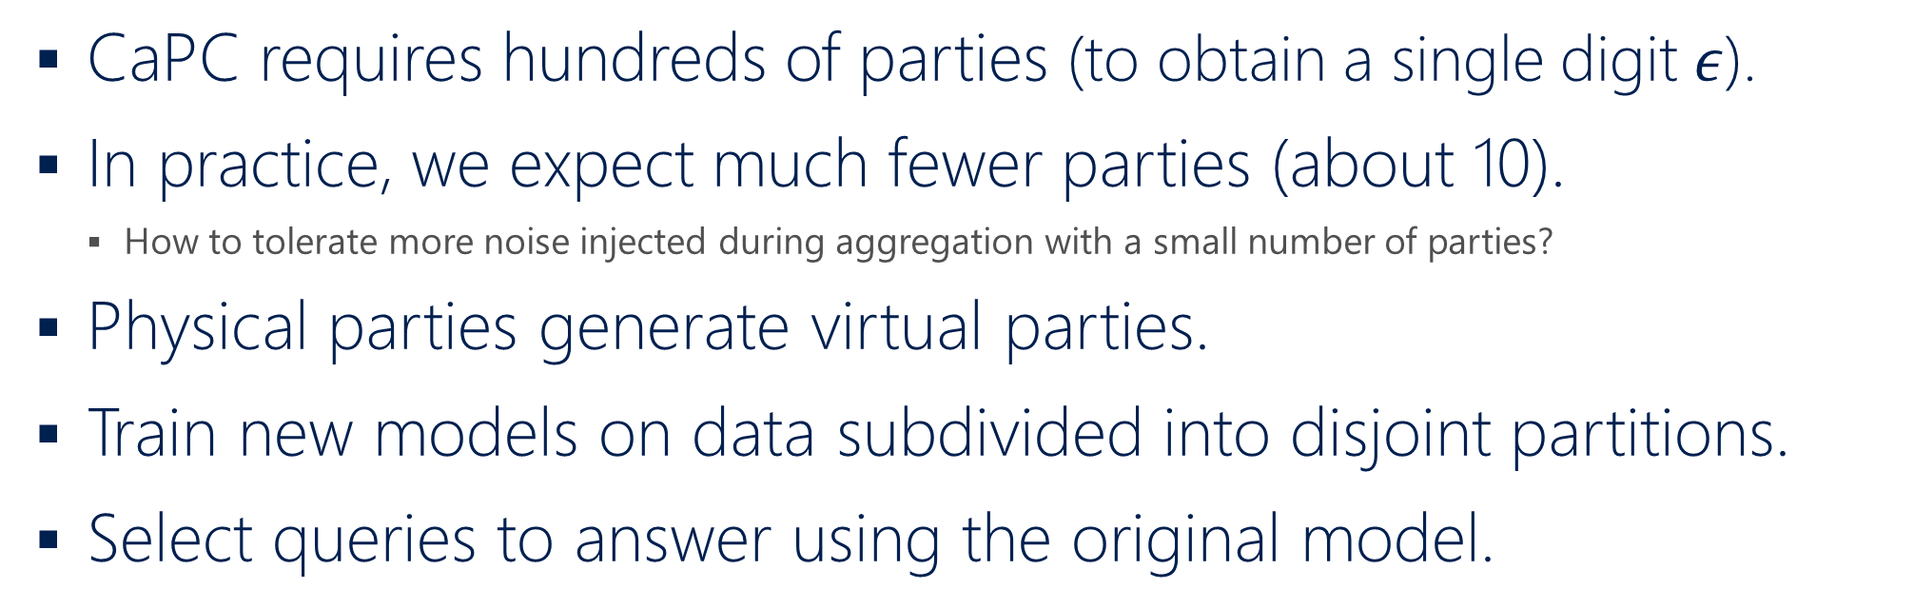
How to decrease number of parties?
CaPC requires hundreds of parties (to obtain a single digit $ε$).
In practice, we expect much fewer parties (about 10).
How to tolerate more noise injected during aggregation with a small number of parties?
Physical parties generate virtual parties.
Train new models on data subdivided into disjoint partitions.
Select queries to answer using the original model.
Physical Party
Virtual Party 1
Virtual Party 2
Virtual Party N
Notes:
One possible solution is to generate virtual parties within each of the physical party. We train new models for the virtual parties on the initial data subdivided into disjoint partitions. Then we have many more parties and a possibility of injection of a larger amount of noise. Additionally, in PATE, the first step is to select queries to answer. We can do it using the original model because in this stage we do not inject any noise and can have a precise answer. Here, we do not overlap data between virtual parties because then the DP analysis does not hold any longer and it is more difficult to analyze privacy in such a case.

Slide 70
Virtual parties improve performance
SVHN dataset, 3 physical parties, 50 virtual parties
2.2%
Notes:
We have preliminary experimental results for virtual parties. The setup is with 3 physical parties. The main goal is to improve the accuracy of the 3 models in the physical parties. Each physical party creates 50 virtual parties. Then one of the 3 parties becomes a querying party. The querying party sends its data to be labeled to the 100 teacher models that are formed from the virtual parties that belong to the other two physical parties. In this case, the virtual models were trained on much less data than the physical models but still such a collaboration improves the accuracy of models in the physical parties by about 2.2%.

Slide 71
CaPC
Taxonomy
71
Notes:
We identify other possible protocols for CaPC to understand how our protocol could be improved to allow smaller number of parties, smaller privacy budget, and to provide better performance, e.g., in terms of accuracy of the models.

Slide 72
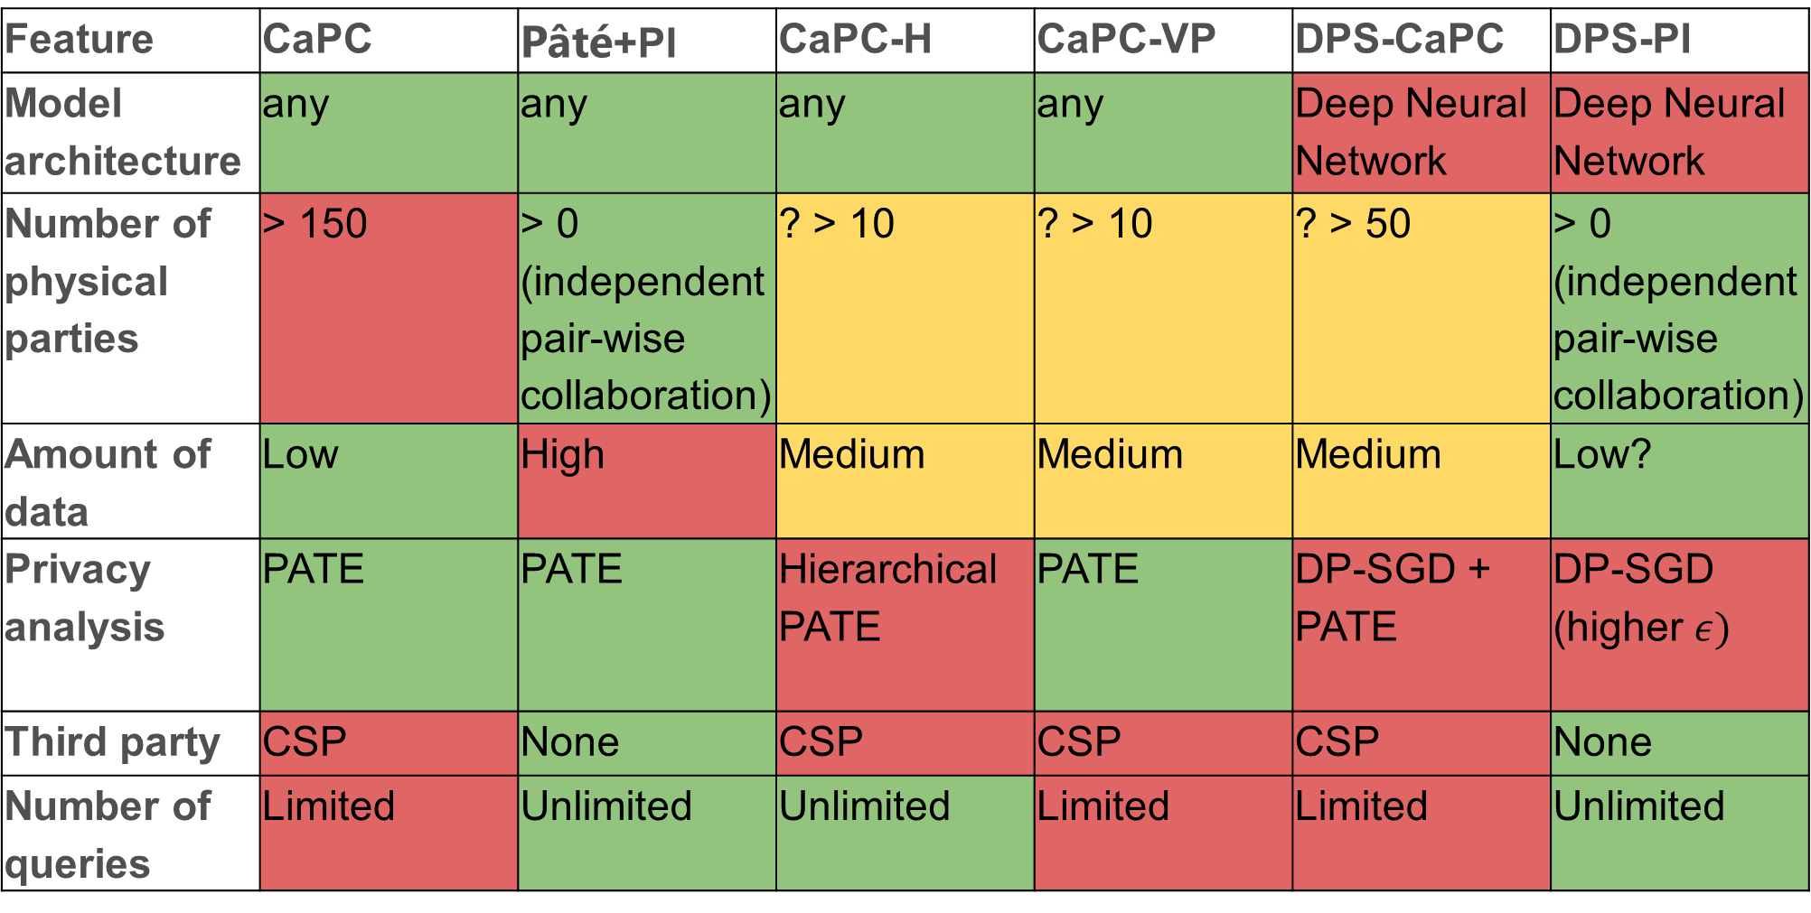
Taxonomy of CaPC
Feature | CaPC | Pâté+PI | CaPC-H | CaPC-VP | DPS-CaPC | DPS-PI
Model architecture | any | any | any | any | Deep Neural Network | Deep Neural Network
Number of physical parties | > 150 | > 0 (independent pair-wise collaboration) | ? > 10 | ? > 10 | ? > 50 | > 0 (independent pair-wise collaboration)
Amount of data | Low | High | Medium | Medium | Medium | Low?
Privacy analysis | PATE | PATE | Hierarchical PATE | PATE | DP-SGD + PATE | DP-SGD (higher $ε)$
Third party | CSP | None | CSP | CSP | CSP | None
Number of queries | Limited | Unlimited | Unlimited | Limited | Limited | Unlimited
72
Notes:
This is an overview of the possible CaPC protocols and we go through them one by one.

Slide 73
The description of the features
Feature | CaPC
Model architecture | any
Number of physical parties | > 150
Amount of data | Low
Privacy analysis | PATE
Third party | Privacy Guardian
# of queries | Limited
Architecture of ML model.
Number of parties that form an ensemble of teacher models and answer queries.
Amount of data required to train the models in the answering parties.
The privacy analysis (e.g., PATE, DP-SGD, etc.).
Is a third-party required and if so what type?
How many queries can be answered by ensemble?
73
Notes:
This is the version of CaPC that we have talked about up to now. First, I will describe the features that we use for our comparison:
Model architecture - the architecture of the machine learning models that can be used for the teachers in the answering parties.
Number of parties that answer queries that are required to form the ensemble subject to privacy and performance constraints: the privacy budget (ε < 10) while exposing a model with high performance (a desired level of accuracy, e.g., > 98% for MNIST).
Amount of data required to train the models in the answering parties subject to the same constraints as in point 2.
Privacy analysis that has to be carried out for a given version of CaPC.
Third party - the minimum is the set of answering and querying parties. The third party such as CSP (Content Service Provider) is required in most versions of CaPC.
Number of queries - that can be asked by a querying party.

Slide 74
Pâté in answering parties & private inference
Feature | Pâté+PI
Model architecture | any
Number of physical parties | > 0 (independent pair-wise collaboration)
Amount of data | High
Privacy analysis | PATE
Third party | None
Number of queries | Unlimited
Simple protocol: run Pâté for each of the answering parties separately.
Run the private inference (e.g., with HE transformer) between a querying party and one of the student answering models.
Revealing the logit vector by the final answering student model does not increase the privacy cost.
The privacy budget incurred only by Pâté to protect the training data.
No third-party required.
74
Notes:
The PATE+PI (which stands for private inference) is the simplest version of CaPC. It uses PATE to expose only a single student model. This ensures that the private data on which the teacher models were trained will not be exposed after this step. The privacy budget is fixed and calculated only once for the queries that were issued to train the student model. We run PATE in each answering party and then the private infrerence between the created student model and querying parties. There is no need for a third-party.
We need a lof data to able able to create hundreds of models in a single party and also need the public data to train the teacher model.
Once we build the student model, we can issue an unlimited number of queries to it since the privacy budget is fixed.

Slide 75
CaPC + many models per answering party
Feature | CaPC-H | CaPC-VP
Model architecture | any | any
Number of physical parties | ? > 10 | ? > 10
Amount of data | Medium | Medium
Privacy analysis | Hierarchical PATE | PATE
Third party | CSP | CSP
Number of queries | Unlimited | Limited
Goal: reduce number of physical parties.
CaPC-H – hierarchical Pâté.
Run Pâté in each & across answering parties.
Requires additional privacy analysis.
CaPC-VP – create Virtual Parties.
Run Pâté on virtual models.
75
Notes:
The goal of CaPC-H and CaPC-VP methods is to reduce the number of participating parties (e.g., hospitals, banks, etc.). CaPC-H is a hierarchical PATE where we run PATE in each answering party separately and then another PATE on top of all the answering parties. This requires additional privacy analysis. CaPC-VP creates the additional virtual parties in each physical party (as shown in the last experiment) but PATE is run only once for all the provided virtual teacher models that are not in the current querying party. One advantage of CaPC-H is that we have student models in each answering party and can ask them unlimited number of queries. On the other hand, CaPC-H requires some public data.

Slide 76
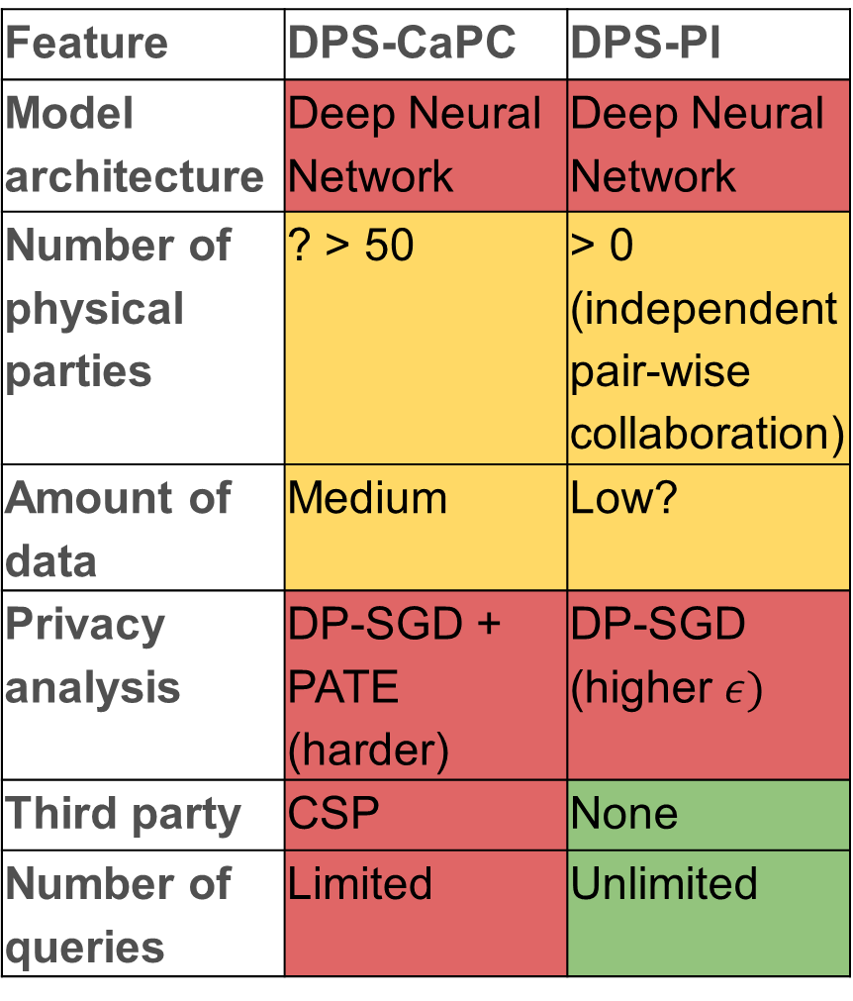
CaPC + many models per answering party
Feature | DPS-CaPC | DPS-PI
Model architecture | Deep Neural Network | Deep Neural Network
Number of physical parties | ? > 50 | > 0 (independent pair-wise collaboration)
Amount of data | Medium | Low?
Privacy analysis | DP-SGD + PATE (harder) | DP-SGD (higher $ε)$
Third party | CSP | None
Number of queries | Limited | Unlimited
Can we combine DP-SGD with Pâté?
Train the teacher models using DP-SGD in each of the answering parties and run Pâté on top of them. Is there any synergy?
This method might decrease the number of answering parties required because some degree of the privacy is already provided in each of the teacher models.
Requires an additional privacy analysis that combines DP-SGD and Pâté.
76
Notes:
We train each teacher model using DP-SGD (which is differential privacy via SGD for deep learning). This method might decrease the number of parties because some degree of the privacy is already provided in each of the teacher models. This approach requires an additional privacy analysis that combines DP-SGD and PATE. It narrows down the architecture of the ML models to the deep learning models. For the DPS-PI (which is DP-SGD + Private Inference), we train the model with DP-SGD and do not aggregate the results via noisy aggregation but run the private inference directly on the model trained with DP-SGD. However, the privacy budget is higher for DP-SGD than for PATE.
DP-SGD – if we can prove that all weights of the two models are observed with probabilities that lie within a predefined boundary of exp(ε) of each other, then we can claim that the training procedure is DP-private with privacy budget epsilon.

Slide 77
Encrypt unlabeled data for confidentiality
Differential Privacy
Answering Parties
Healthy
Cancer
Querying
Party
Encrypted
Unlabeled
Data
77
Notes:
The second desideratum of CaPC is to preserve the confidentiality of the unlabeld data. Thus, this data is sent and processed in encrypted form. This is done via secure multi-party computation and homomorphic encryption.

Slide 78
Distributed Collaborative Learning
Inference
Aggregation
Labels
Unlabeled Data
78
Notes:
In our work, we consider a distributed collaborative learning. Our goal is to train the red model presented on the right-hand side. We have some unalabeled data. We send the data to many other models for inference. These models label the data and we aggregate the labels into a single label per data point. Then these new labels in combination with the unlabeled data are used to train the red model.

Slide 79
Multi-label classification
79
Notes:
We identify other possible protocols for CaPC to understand how our protocol could be improved to allow smaller number of parties, smaller privacy budget, and to provide better performance, e.g., in terms of accuracy of the models.

Slide 80
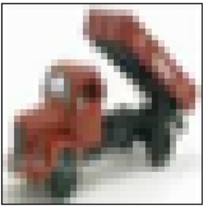
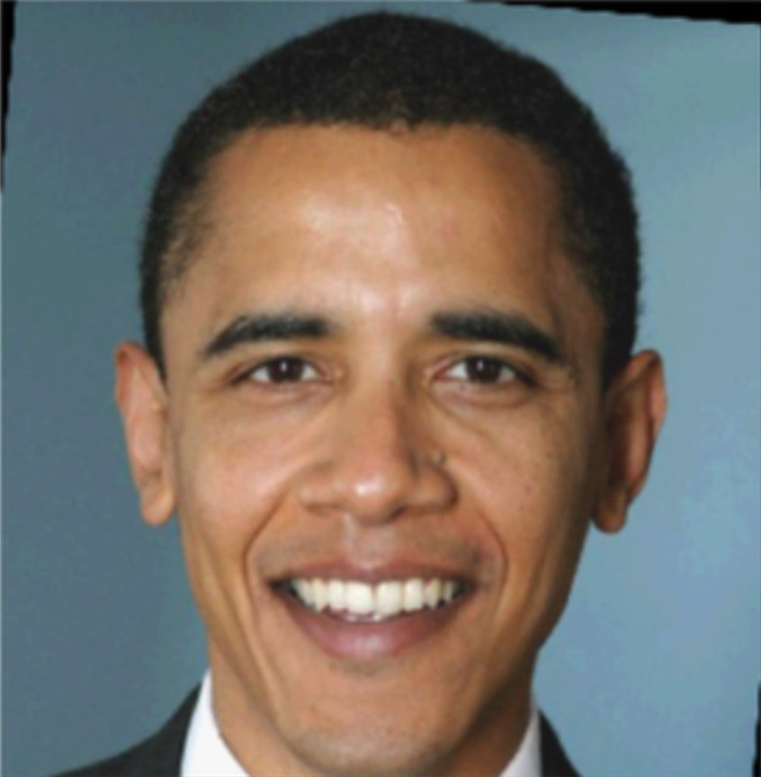
Multi-class classification
0 | 0 | 0 | 0 | 0 | 0 | 0 | 0 | 0 | 1
airplane | automibile | bird | cat | deer | dog | frog | horse | ship | truck
Multi-label classification
0 | 1 | 1 | 1 | 0
Young | Male | Smiling | Oval face | Eyeglasses
Notes:
Now, we’ll move on to discuss how to use PATE for the multi-label classification. So, for multi-class classification we have to find a single correct class for a given image. Here, we have an image from the CIFAR10 dataset and want our model to classify this image as a truck. For the multi-label classification, we have to find which labels apply to a given image. Here, for an image of president Obama and we want our model to indicate which labels out of 5 might be present in this image, for instance, our model correctly classifies that Mr. Obama is smiling.

Slide 81
Pâté
Multi-class classification
0 | 0 | 0 | 0 | 0 | 0 | 0 | 0 | 0 | 1
airplane | automibile | bird | cat | deer | dog | frog | horse | ship | truck
Multi-label classification
classification:
0 | 1 | 1 | 1 | 0
label:
A | B | C | D | E
Notes:
Let’s simplify the labels for the multi-label classification and consider running PATE in both types of machine learning tasks. As of now PATE can be used for the multi-class classification. The question is: how can we run it for the multi-label classification?

Slide 82
Transform from Multi-label to Multi-class
Multi-label:
0 | 1
label:
A | B
Multi-class:
0 | 0
0 | 1
1 | 0
1 | 1
class:
0
1
2
3
Notes:
Let us assume that we have two labels for every data point. The label powerset (LP) transformation creates one binary classifier for every label combination present in the training set. For example, if possible labels for an example were A and B, the label powerset representation of this problem is a multi-class classification problem with the 4 classes: 00, 01, 10, and 11.

Slide 83
Transform from Multi-label to Multi-class
Multi-label:
0 | 1
label:
A | B
Multi-class:
0 | 0
0 | 1
1 | 0
1 | 1
class:
0
1
2
3
CelebA dataset with 40 labels requires $2^{40}$ classes
Notes:
Let us assume that we have two labels for every data point. The label powerset (LP) transformation creates one binary classifier for every label combination present in the training set. For example, if possible labels for an example were A and B, the label powerset representation of this problem is a multi-class classification problem with the 4 classes: 00, 01, 10, and 11. The problem is that if we have 40 labels like in the CelebA dataset, the number of classes increases exponentially to 2^40. We expect that this approach might work well only for up to a few labels.

Slide 84
Transform from Multi-label to Binary-class
Multi-label:
0 | 1
label:
A | B
label:
A
label:
B
positive:
0
negative:
1
positive:
1
negative:
0
Notes:
Another transformation is to treat each label as a separate binary classifier.

Slide 85

Pâté
Multi-class classification
0 | 0 | 0 | 0 | 0 | 0 | 0 | 0 | 0 | 1
airplane | automibile | bird | cat | deer | dog | frog | horse | ship | truck
Multi-label classification
classification:
0
(negative
outcome)
0 | 1
label:
A
$$≡$$
present (positive) | absent (negative)
Notes:
We focus on the output from PATE. In the multi-class case, the PATE should return truck as the correct class. For the multi-label classification, let us focus on a single label. Let it be label A. It is equivalent to selecing a class for this label to be either positvive (a disease present) or +1 or a negative class (a disease is absent) or 0.

Slide 86

Pâté output
Multi-class classification
0 | 0 | 0 | 0 | 0 | 0 | 0 | 0 | 0 | 1
airplane | automibile | bird | cat | deer | dog | frog | horse | ship | truck
Multi-label classification
positive:
negative:
0 | 1
0
1
$$≡$$
present (positive) | absent (negative)
label:
A
Notes:
We focus on the output from PATE. In the multi-class clase, the PATE should return truck as the correct class.
For the multi-label classification,

Slide 87
Pâté votes
Multi-class classification
0 | 0 | 0 | 0 | 0 | 0 | 0 | 1 | 14 | 34
airplane | automibile | bird | cat | deer | dog | frog | horse | ship | truck
Multi-label classification
8 | 42
label:
A
present (positive) | absent (negative)
Notes:
The first part of the model for CheXpert is a general feature extraction, for example, using DenseNet-121 pretrained on ImageNet. For a given X-ray image, we extract its features. The last few layers of the model are task specific (an attention map, batch norm, and fully-connected). For a given image, these specialized layers are run separately for each class, so there is a separate single logit computed per class. At the end, we combine the logits into a single vector.
Advanced composition theorem 3.2.0 Aren loks book
Elen’s book epsilon k for each of the binary classifiers.

Slide 88
Pâté privacy
analysis
Multi-class classification
truck:
34
ship:
14
single data point
Multi-label classification
positive:
8
negative:
42
single label A out of 5 for this data point
Notes:
The first part of the model for CheXpert is a general feature extraction, for example, using DenseNet-121 pretrained on ImageNet. For a given X-ray image, we extract its features. The last few layers of the model are task specific (an attention map, batch norm, and fully-connected). For a given image, these specialized layers are run separately for each class, so there is a separate single logit computed per class. At the end, we combine the logits into a single vector.
Advanced composition theorem 3.2.0 Aren loks book
Elen’s book epsilon k for each of the binary classifiers.

Slide 89
Pâté privacy
analysis
Multi-class classification
truck:
34
ship:
14
Gap: 20
Multi-label classification
positive:
8
negative:
42
Gap: 34
Notes:
The first part of the model for CheXpert is a general feature extraction, for example, using DenseNet-121 pretrained on ImageNet. For a given X-ray image, we extract its features. The last few layers of the model are task specific (an attention map, batch norm, and fully-connected). For a given image, these specialized layers are run separately for each class, so there is a separate single logit computed per class. At the end, we combine the logits into a single vector.
Advanced composition theorem 3.2.0 Aren loks book
Elen’s book epsilon k for each of the binary classifiers.

Slide 90
Pâté threshold
mechanism
Multi-class classification
0 | 0 | 0 | 0 | 0 | 0 | 0 | 0 | 0 | 1
Decide whether to answer this query.
Multi-label classification
classification:
0 | 1 | 1 | 1 | 0
label:
A | B | C | D | E
Decide which labels to answer in this data point.
Provide only answered items to a loss function.
Notes:
Each label as a single query.
Original threshold – per input bases.
Threshold mechanism per label bases. Binary classification problem. Multiple quries with exactly the same input. These queries are related. They have the same image / input data.

Slide 91
Pâté answer
Multi-class classification
Query | Class
1 | truck
2 | ship
3 | ⊥
4 | dog
5 | frog
Multi-label classification
Query | A | B | C | D | E
1 | F | ⊥ | ⊥ | T | ⊥
2 | ⊥ | T | ⊥ | F | ⊥
3 | ⊥ | F | ⊥ | ⊥ | ⊥
4 | ⊥ | F | ⊥ | F | ⊥
5 | T | ⊥ | ⊥ | T | ⊥
Count > T:
reveal data point
Notes:
These are the final answers from PATE. If you are a careful reader, you might discern a hidden message in this slide “Clever Hans”, the red bottom signs ⊥s form the first letter C and H from the name of our lab.
The privacy has to be analyzed holistically. By refusing to reply (by assigning bootom ⊥) to a given label, we also reveal some information – in this case our ensemble of teacher models was not confident enough.

Slide 92
Multi-label classification with Pâté
Each label is a separate binary or multi-class classification.
Privacy analysis for each label (binary or with more classes) is equivalent to a single classification per data point in the multiclass classification.
Pâté mechanisms is independent on the number of classes. The privacy analysis looks only into two classes with most votes (argmax & runner-up).
Larger number of classes decreases accuracy per trained model (fewer samples per class) and usually the gaps between top two classes (with argmax & runner-up votes) are smaller.

Slide 93
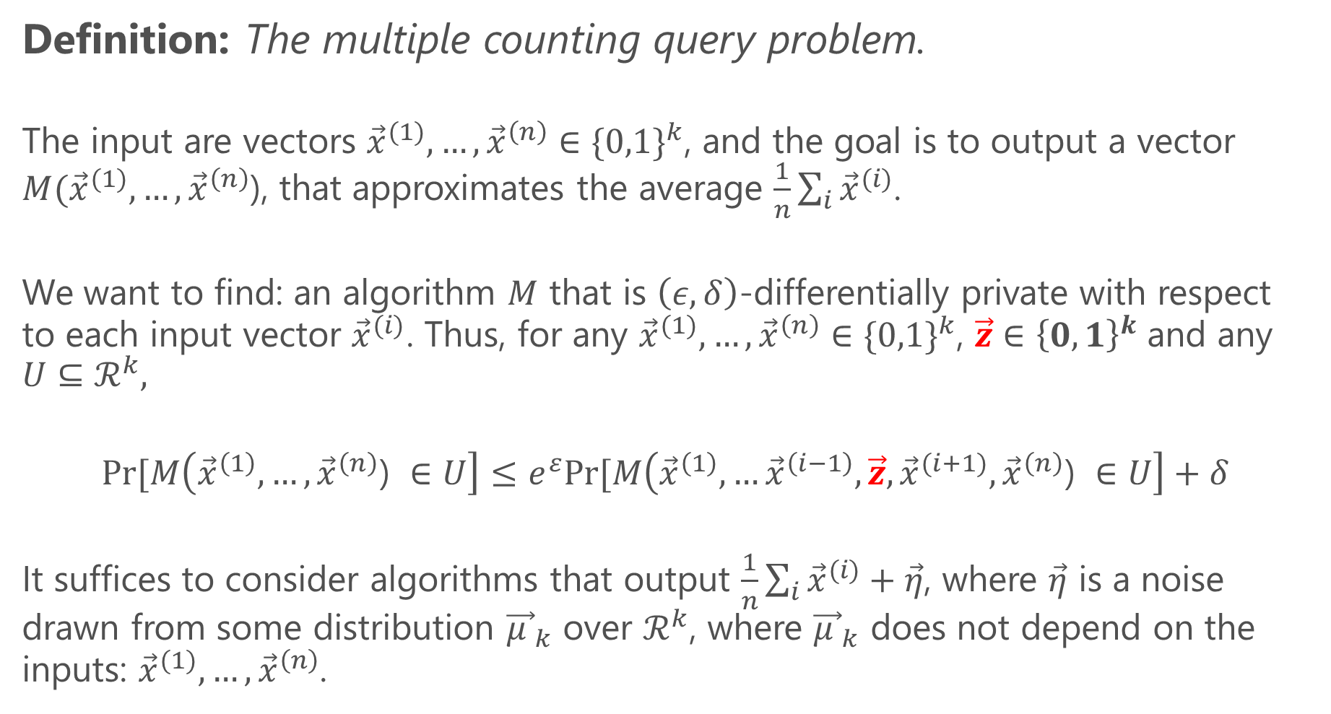
Multi-label classification via counting queries
Definition: The multiple counting query problem.
The input are vectors ${\vec{x}}^{(1)}, …,{\vec{x}}^{\left(n\right)}∈{\{0,1\}}^{k}$, and the goal is to output a vector $M({\vec{x}}^{(1)}, …,{\vec{x}}^{\left(n\right)}$), that approximates the average $\frac{1}{n}\sum_{i}{{\vec{x}}^{(i)}}$.
We want to find: an algorithm $M$ that is $\left(ε, δ\right)$-differentially private with respect to each input vector ${\vec{x}}^{(i)}$. Thus, for any ${\vec{x}}^{(1)}, …,{\vec{x}}^{\left(n\right)}∈{\{0,1\}}^{k}$, $\vec{z}∈{\left\{0,1\right\}}^{k}$ and any $U⊆ℛ^{k},$
$$Pr⁡[M\left({\vec{x}}^{\left(1\right)}, …,{\vec{x}}^{\left(n\right)}\text{)} ∈U\right]≤e^{ε}Pr⁡[M\left({\vec{x}}^{\left(1\right)}, …{\vec{x}}^{\left(i−1\right)},\vec{z},{\vec{x}}^{(i+1)},{\vec{x}}^{\left(n\right)}\text{) }∈U\right]+δ$$
It suffices to consider algorithms that output $\frac{1}{n}\sum_{i}{{\vec{x}}^{(i)}}+\vec{η}$, where $\vec{η}$ is a noise drawn from some distribution ${\vec{μ }}_{k}$ over $ℛ^{k}$, where ${\vec{μ }}_{k}$ does not depend on the inputs: ${\vec{x}}^{(1)}, …,{\vec{x}}^{\left(n\right)}$.
Notes:
The previous 2 approaches to multi-label classification were machine learning based. Here, we would like to model the problem based on the standard algorithm from the privacy literature called the multiple counting query. In our case, the input vectors would be the vectors of sigmoid outputs from teacher models, and the output being the approximated average that would express the probability if a given label is present or absent.

Slide 94
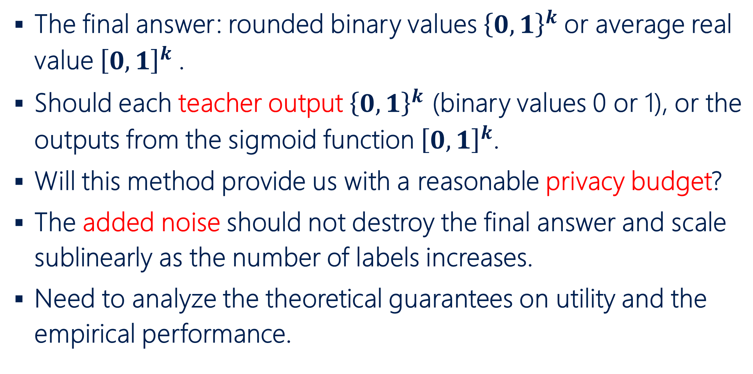
Multi-label via the approximated mean value
The final answer: rounded binary values ${\left\{0,1\right\}}^{k}$or average real value ${\left[0,1\right]}^{k}$.
Should each teacher output ${\left\{0,1\right\}}^{k}$ (binary values 0 or 1), or the outputs from the sigmoid function ${\left[0,1\right]}^{k}$.
Will this method provide us with a reasonable privacy budget?
The added noise should not destroy the final answer and scale sublinearly as the number of labels increases.
Need to analyze the theoretical guarantees on utility and the empirical performance.

Slide 95



Multi-label: model lack of answer $⊥$
$$0$$
$$⊥$$
$$1$$
0.0
1.0
0.25
0.75
Refrain from answer if probability in range [0.25, 0.75].
Notes:
We can model the lack of answer in the region from 0.25 to 0.75 in terms of the probability.

Slide 96
Further extension to CaPC
The end-to-end encryption via training the teacher models on encrypted data (e.g., from patients).
Can we incorporate a possibility of an insider attack?
Current threat model is honest but curious.
Better system for private inference that could replace or improve he-transformer (MP2ML), Delphi, or CrypTFlow2.
How to handle Out-Of-Distribution data for teacher models?
Vertical partitioning of labels and features.
Use Pâté for other ML tasks (e.g., multi-label classification).
Privacy analysis for the multi-label classification with Pâté.
Notes:
This is a laundry list of other open problems in CaPC.
Can we also train the teacher models on encrypted data? There could be a trusted data curator involved.
We do not want s full malicious model but some guarantees against corrupted parties. For instance, what could happen if parties collude or some of them are corrupted?
How to handle the Out-Of-Distribution data for teacher models? We

